Slide 1



Leveraging the Genetic Contribution of Drug Use Patterns From 42,776,151 Purchases in the Finnish National Drug Registry
Novartis Interview for Human Genetics Data Scientist,
Chemical Biology and Therapeutics
November 24th, 2021
Kumar Veerapen, PhD
Computational Scientist I
Daly and Neale labs
@mkveerpn
veerapen@broadinstitute.org
#ATGUstrong

Slide 2
Slide #1
Genetic Bottleneck
EARLY SETTLEMENT
2000-10 000 years ago
South and Coast
LATE SETTLEMENT
16th century
multiple bottle necks
Genetic Bottleneck
LATE
SETTLEMENT
EXPANSION
18th century – population 250 000
Today – population 5.4 million
EARLY
SETTLEMENT

Slide 3
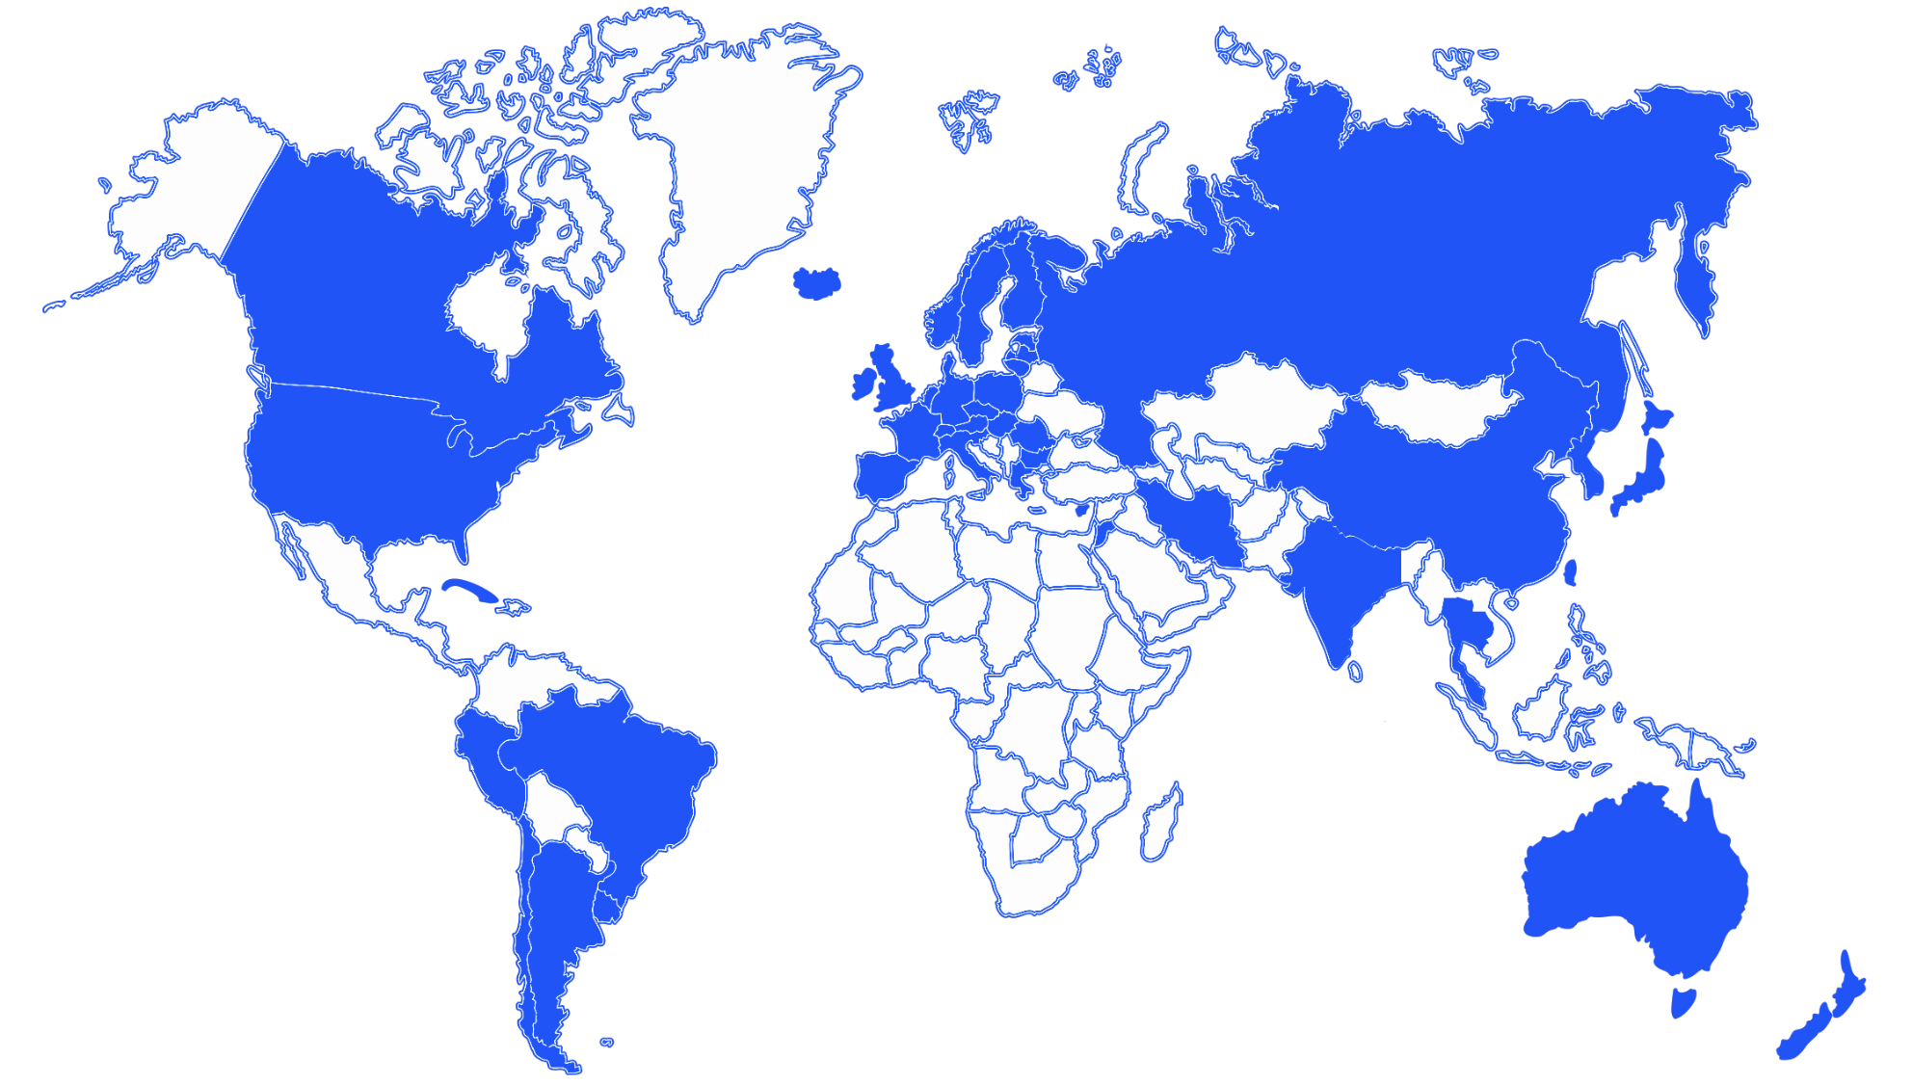
Why Finland?
Slide #2
Countries with Biobanks
Universal Healthcare
Unique personal identity code
Isolated population
Recalling made easy
(biobank act + social security number)
X

Slide 4
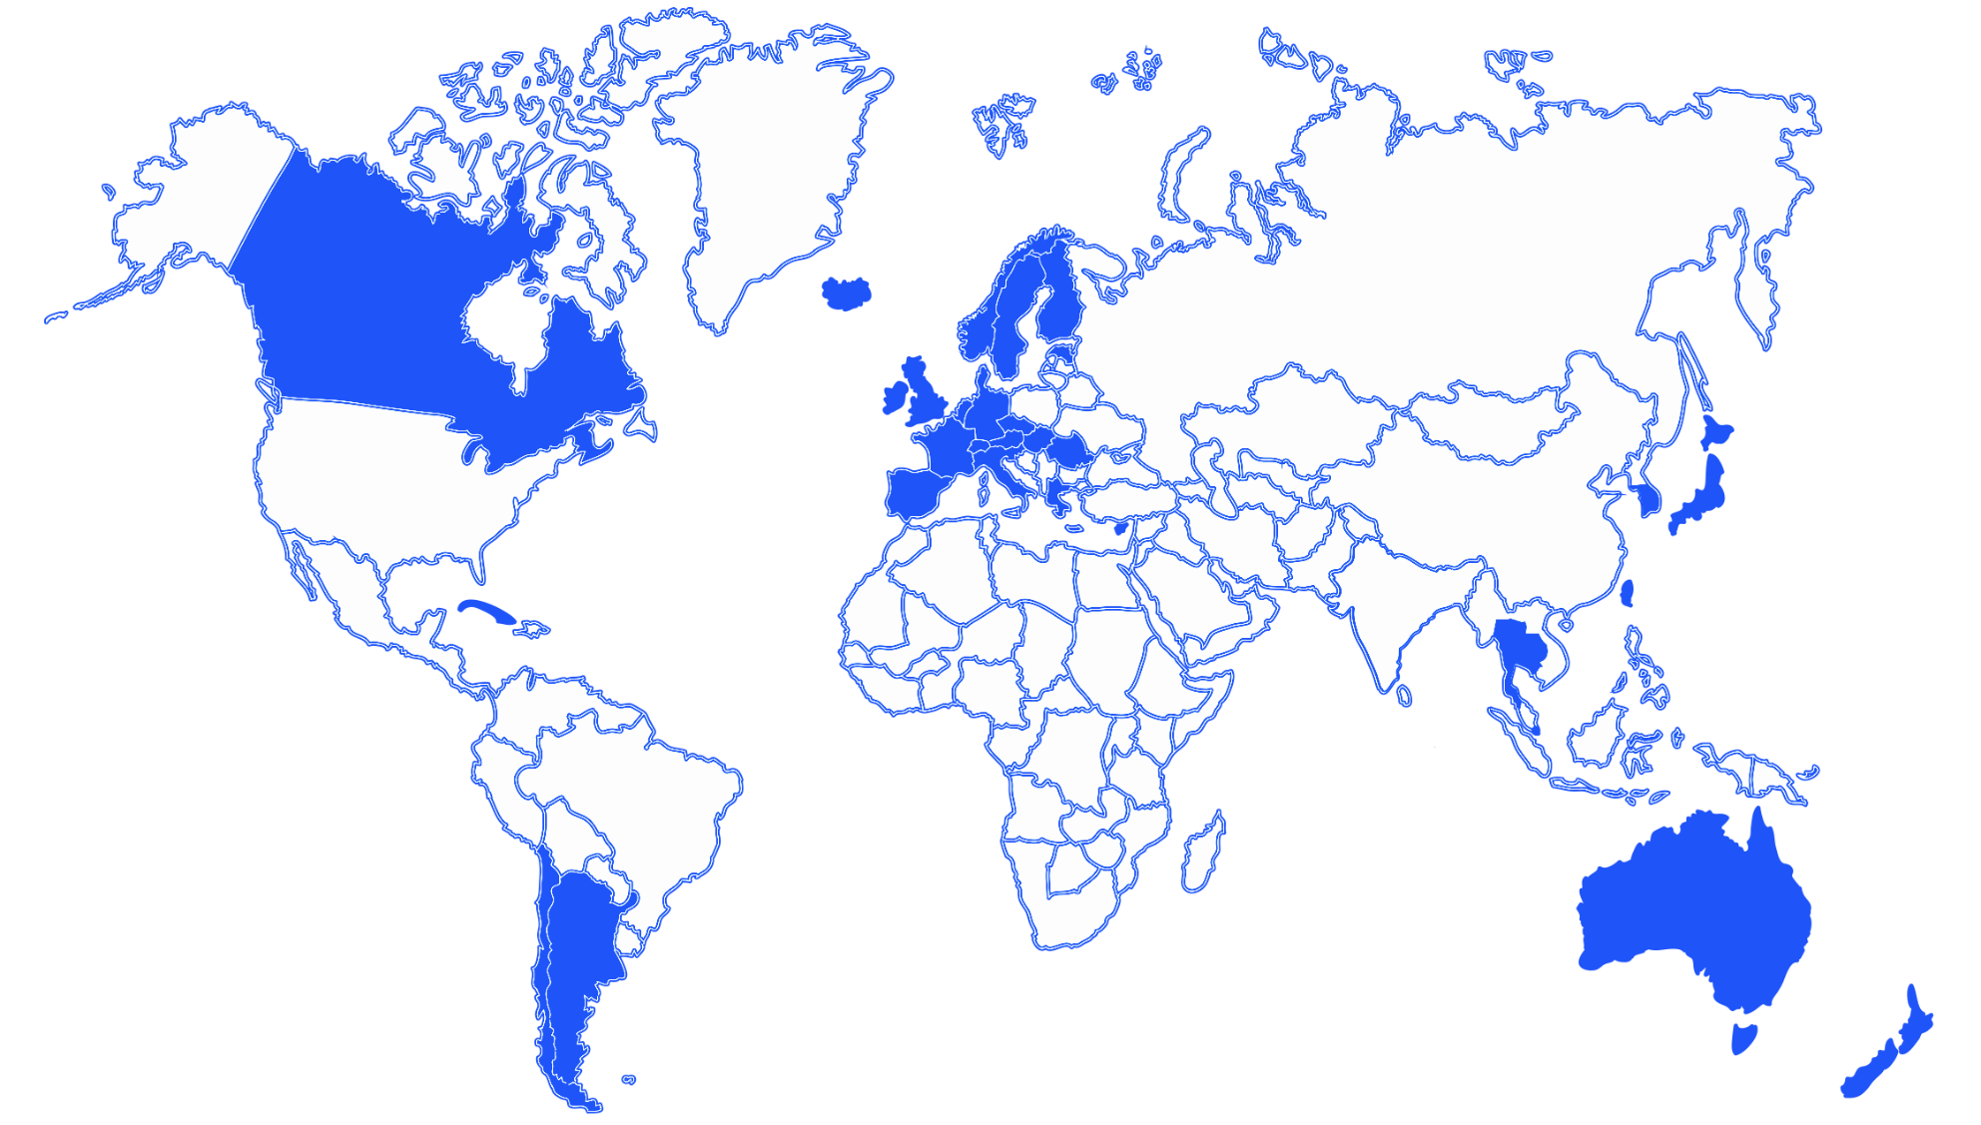
Why Finland?
Slide #3
Countries with Biobanks
Universal Healthcare
Unique personal identity code
Isolated population
Recalling made easy
(biobank act + social security number)
X
X

Slide 5
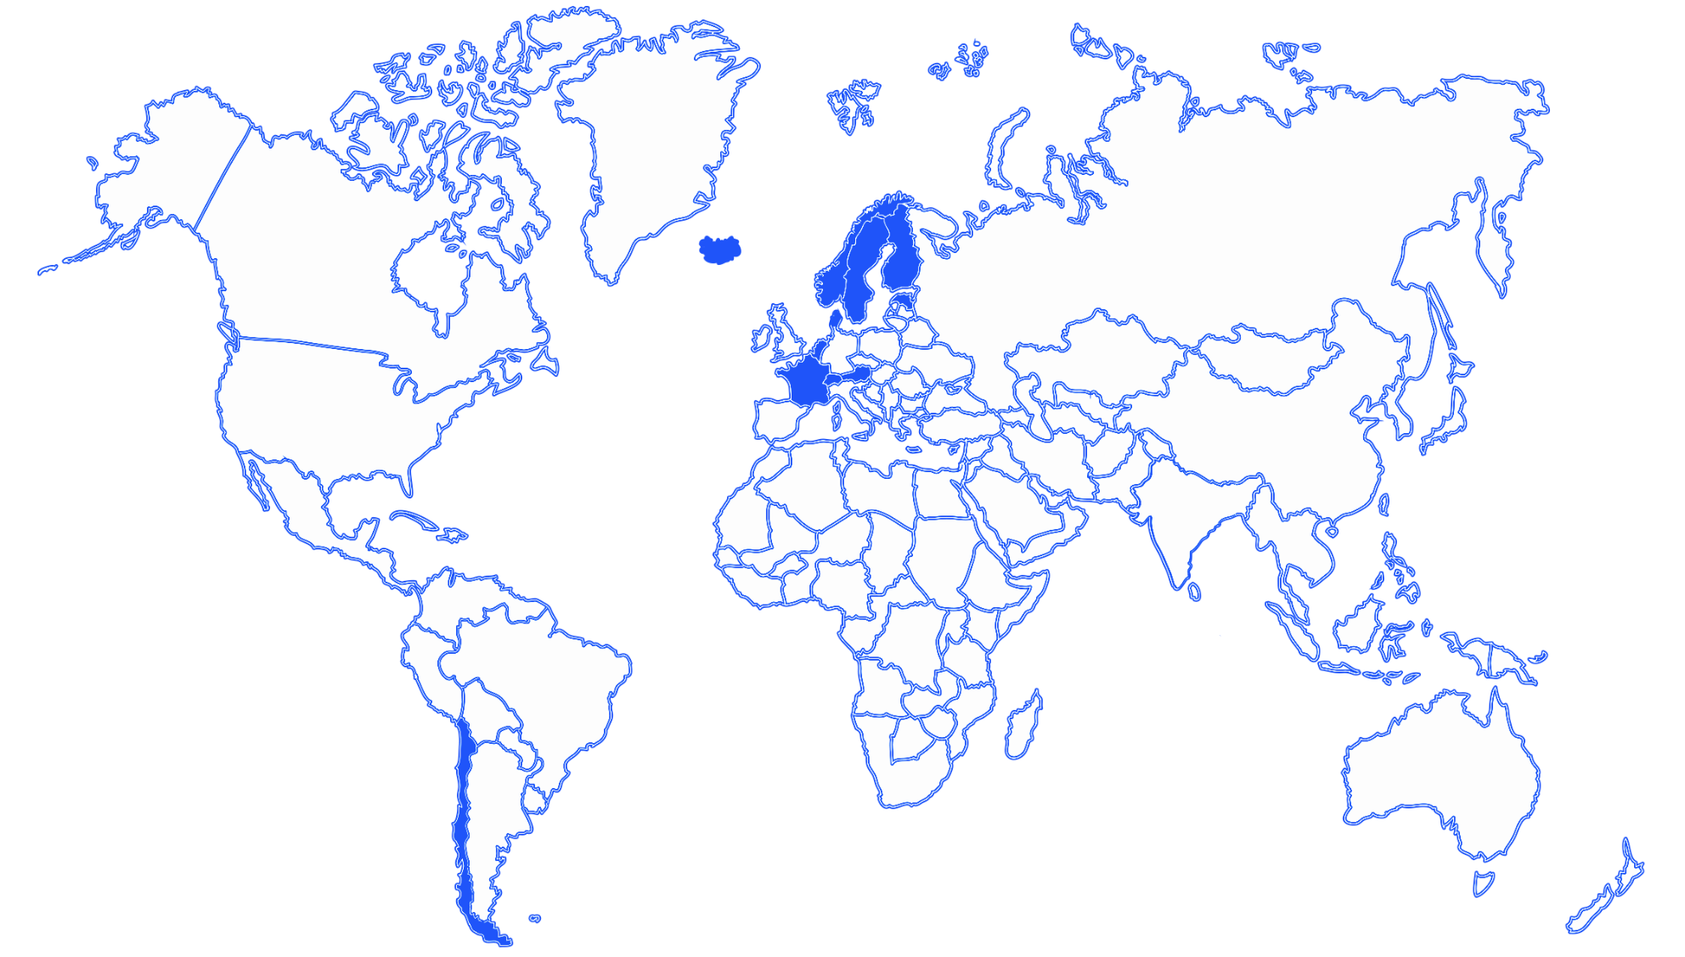
Why Finland?
Slide #4
Countries with Biobanks
Universal Healthcare
Unique personal identity code
Isolated population
Recalling made easy
(biobank act + social security number)
X
X
X

Slide 6
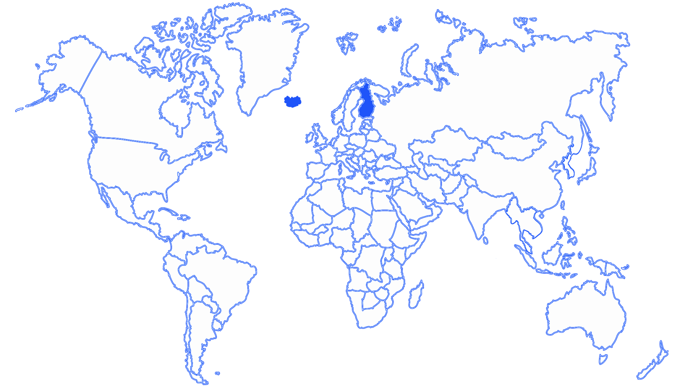
Why Finland?
Slide #5
Countries with Biobanks
Universal Healthcare
Unique personal identity code
Isolated population
Recalling made easy
(biobank act + social security number)
X
X
X
X

Slide 7
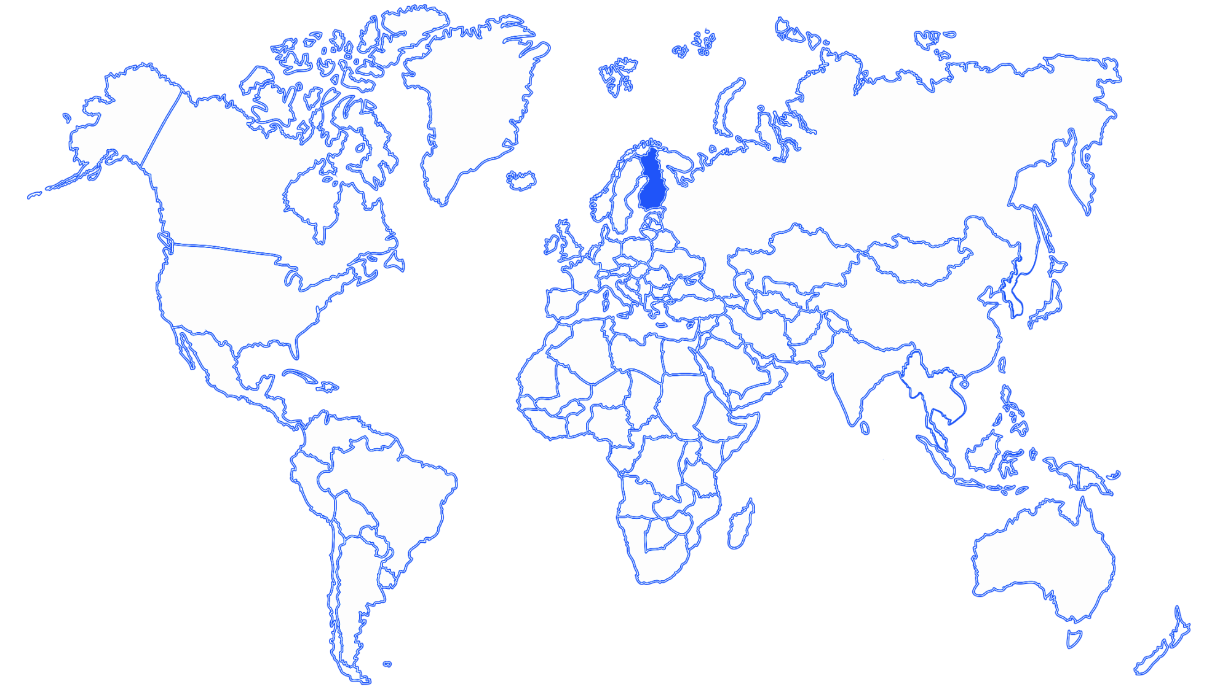
Why Finland?
Slide #6
Countries with Biobanks
Universal Healthcare
Unique personal identity code
Isolated population
Recalling made easy
(biobank act + social security number)
X
X
X
X
X

Slide 8
Slide #7
+
+
+
POPULATION ISOLATE
HEALTH
REGISTERS
BIOBANKS
GENOME DATA
INNOVATIVE STUDY DESIGNS
Notes:
Every patient is linked with a longitudinal aspect of their data from essentially being born to death

Slide 9
Slide #8
Generating Results from FinnGen
Population samples
218,792 individuals
Combined genotype and register data
Imputation
Total markers: 16,962,023
Genotyping
(655,973 markers)
National register data
(Prescription Drug Purchase)
Years captured: 1995 - 2017
Longitudinal data points: 84,477,978
Drug Purchases: 42,776,151
Hospital biobank samples
Blood Service’s biobank
Association analyses
Current data freeze for release 5:
218,792 individuals

Slide 10
Along with Genotype Data, Many Other Things Make an Endpoint?
Slide #9
Cancer Registry
(n = 46,876)
(1953 to 2016)
Morphology and Topology (ICD-O-3)
Drug Registry (KELA)
(n = 42,776,151 purchases; 310,152 reimbursements)
(1995 to 2017)
Diagnosis (KELA); Drugs (ATC and VNR Codes)
FINNGEN ID with multiple entries (Event Dates)
VNR contains drug dosage and package size
ATC (n=27917) contains drug family and
subgroup information
Causes of Death
(n = 35,145)
(1966 to 2017)
ICD 8/9/10
Endpoints
Outpatient Clinics
(n= 4,155,526 procedures;
10,902,854 specialist;
21,496,596 primary out)
(1998 to 2017)
Procedures (CPT) and Diagnosis (ICD 9/10)
Notes:
HILMO -- Social Welfare and Health Care
CPT -- Current Procedural Terminology
KELA -- KELA -- Social Insurance
Institution (Social Security)
ATC – Anatomical Therapeutic Chemical
VNR – Nordic Article Number
Inpatient Registry (HILMO)
(n = 1,898,128; 2,856,550)
(1953 to 2016)
Procedures (CPT) and Diagnosis (ICD 8/9/10)
Notes:
#CANC DEATH INPAT OPER_IN OPER_OUT OUTPAT PRIM_OUT PURCH
#46876 35145 2856550 1898128 4155526 10902854 21496596 42776151
#REIMB
#310152
21,496,596

Slide 11
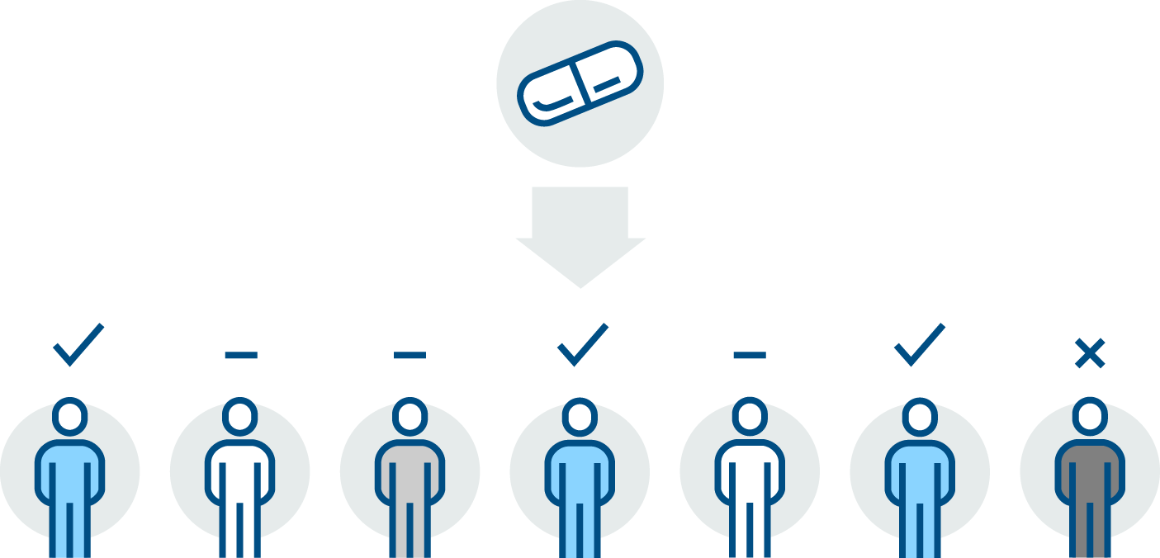


Project 1: SSRI Drug Response Variability
Slide #10
Selective Serotonin
Reuptake Inhibitors
(SSRI)
In FinnGen, high correlation between depression and the use of SSRI
(r² = 0.518)
Prescribed to MDD patients
Response
No effect
Adverse Response
53-65% MDD patients respond to SSRI
(Hamilton Rating Scale for Depression)
(Hirschfeld et al 1999, J Clin Psychiatry)
Note: MDD – Major Depressive Disorder

Slide 12
Objective
Slide #11
To understand the genetic basis of SSRI response variability by leveraging genotype-drug purchase data from 218,792 individuals in FinnGen Release 5.
Stellar abstract award: HSPH PQG 2020
Reviewers Choice Award: ASHG 2020
Platform presentation: WCPG 2020

Slide 13
Analysis Plan
Slide #12
Genotyped and Imputed:
Total markers: 16,962,023
Antidepressant Purchases
218,792 individuals with 1,711,695 purchases
Years = 1995 to 2017
Association Analysis (SAIGE v0.42.1) Phenotypes tested adjusting for sex, age, batch, and first 10 PCs:
SSRI Number of Purchases
SSRI Dosage Change over Time
Significance threshold: p < 5x10⁻⁸
Longitudinal SSRI Purchases
51,519 individuals
853,286 purchases
Notes:
don't spell out your covariates (just say "adjusted for a number of covariates" and leave them on the slide for people to read)
What is SAIGE?

Slide 14


Longitudinal Drug Purchase Data is Incredibly Rich but also….
Slide #13
Marilisa Neri

Slide 15

Analysis 1: SSRI vs non-SSRI
Slide #14
Trait type:
Binary
Purchaser vs non-purchaser
VS
Minimum of ONE SSRI purchase
NO / ZERO record of SSRI purchase
N_{SSRI} = 41,147
N_{non-SSRI} = 159,788
Question:
Are there genetic differences observed with the purchase of SSRI?

Slide 16
MDD Polygenic Risk is different in SSRI vs no-SSRI
Slide #15
Non-SSRI
SSRI
MDD to Antidepressants:
r_{g} = 0.997
MDD to SSRI:
r_{g} = 0.732
β = 0.234
p = 0.0149
Non-SSRI
SSRI
Note:
r_{g} – genetic correlation
MDD – major depressive disorder
SSRI – selective serotonin reuptake inhibitor
Summary statistics for PRS from
Wray et al 2018 Nat Gen

Slide 17
Analysis 1: Number of SSRI Purchases
Slide #16
Trait type:
Quantitative
Number of purchases per individual
Range: 0 (no purchase record) – 288
Median: 7 purchases per individual
Question:
Are there genetic variants associated with the variability in purchase frequency of SSRI?

Slide 18
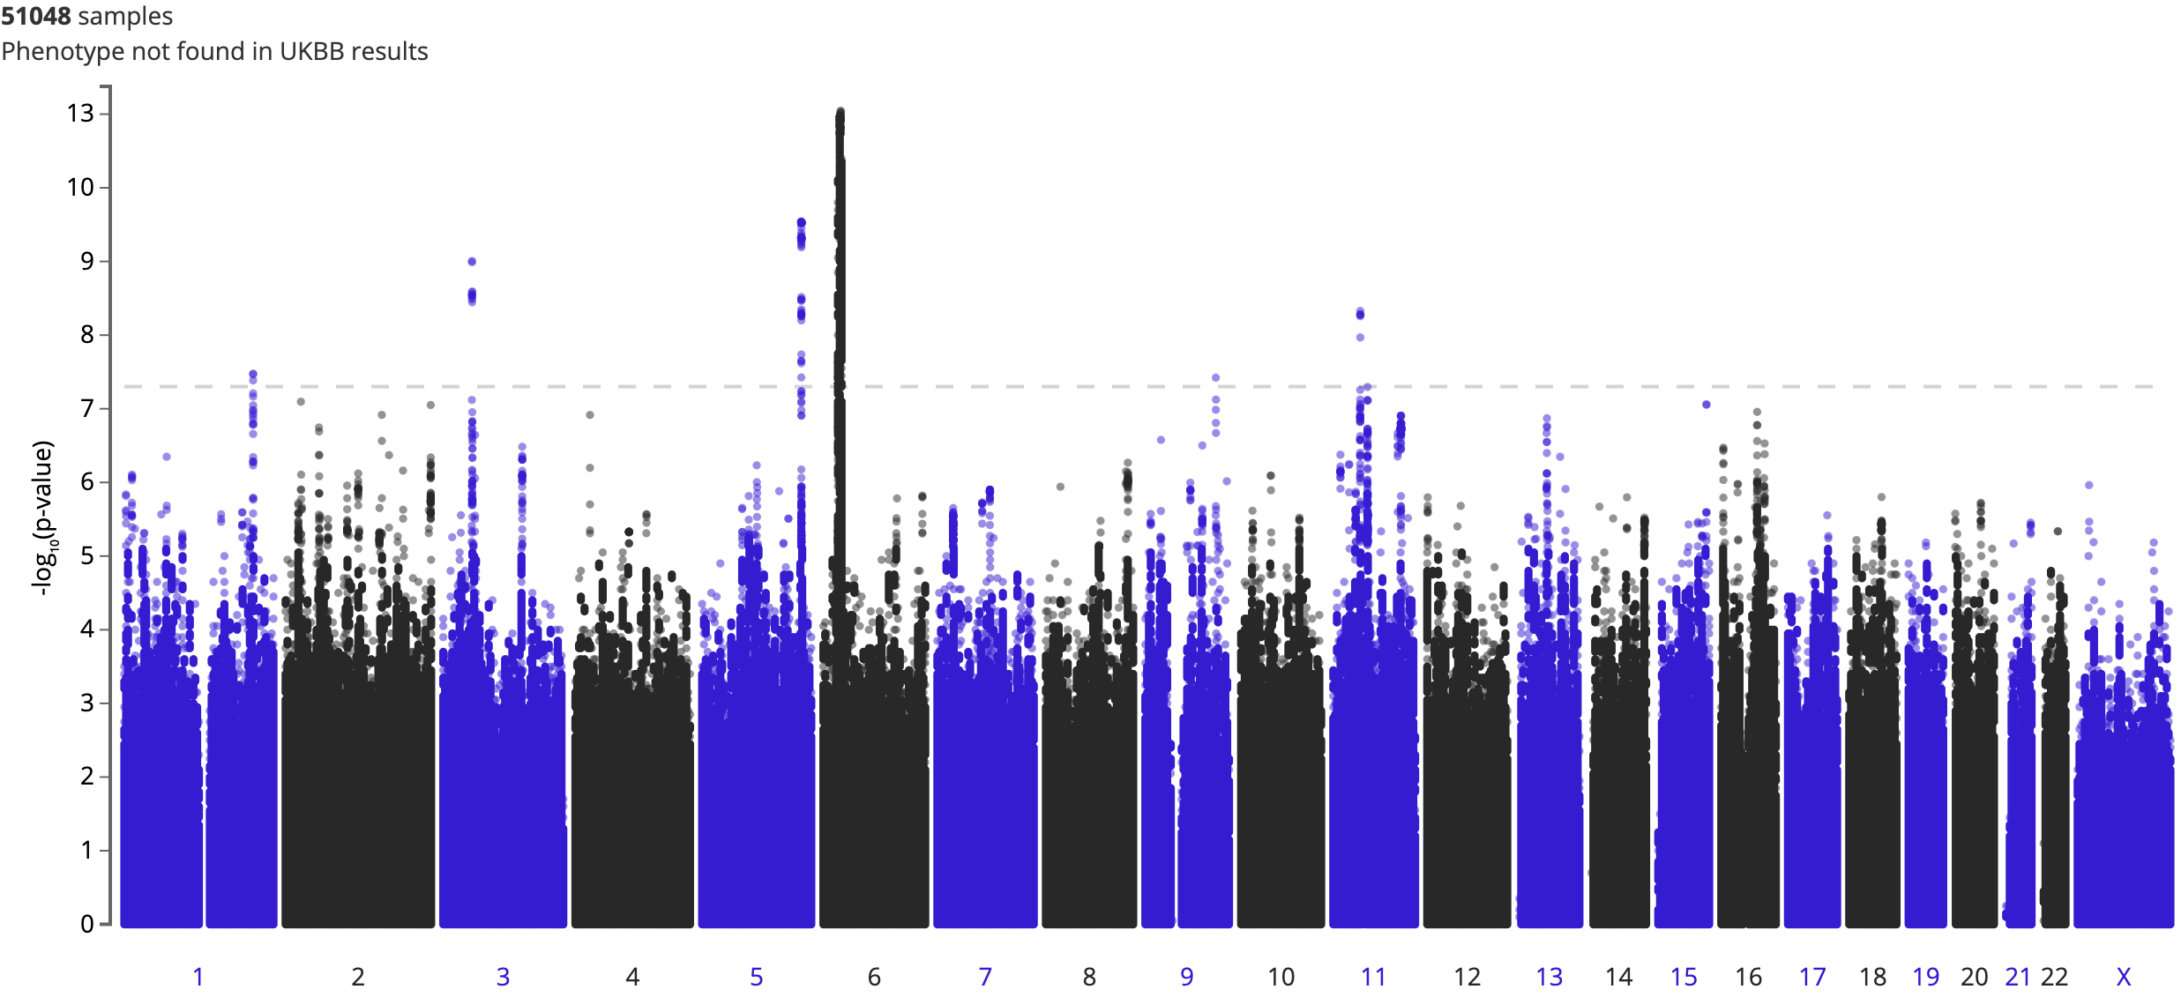
SSRI Purchases (Per Individual) (N = 200,935)
Slide #17
ARIH2
chr3:48972137:C:G
(intron)
AF_{FIN} = 0.1883
AF_{NFE} = 0.1257
β = -0.0185
RNF39
chr6:30070870:T:C
(3’ UTR)
AF_{FIN} = 0.05355
AF_{NFE} = 0.1024
β = -0. 0345
Endpoint: Quantitative
Range: 0 (no purchase record) – 288
Median: 7 purchases per individual
Inverse Rank Normalized
PHF21A
chr11:46035522:T:C
(intron)
AF_{FIN} = 0.1988
AF_{NFE} = 0.1715
β = 0.0165
PROX1
chr1:213928283:A:G
(Intron)
AF_{FIN} = 0.4105
AF_{NFE} = 0.5176
β = -0.0125
MAT2B
chr5:165056066:G:T
(intron)
AF_{FIN} = 0.5922
AF_{NFE} = 0.5223
β = 0.0143
TLR4
chr9:117728182:A:G
(intergenic)
AF_{FIN} = 0.01041
AF_{NFE} = 0.003856
β = -0.0605
S-Adenosyl methionine (SAMe) could be used as a supplement but still remains inconclusive (Cuomo et al 2020 Annals Gen Psych)
Systemic TLR4 is reduced with SSRI intake (Wang et al 2020 Neuroscience)
Note:
AF – gnomAD allele frequencies in Finns (FIN) and Non-Finnish Europeans (NFE)
Notes:
MAT2B found in Howard’s paper Methionine regulation
SAMe (S-adenosyl-L-methionine) used but not proven as a supplement to augment SSRI
SSRI and TLR4 – TLR4 is normalized in SSRI intake.
TLR4 close to metaanlaysis signal for MDD ~6KB
D’ = 1 and report more on R2, if you have a true signal R2 * chisq of true SNP, associations decay with R2
But these disappear when we remove the assumption that non-purchases are equal to 0
Across the board
But is there a genetic factor to purchases within the SSRI

Slide 19
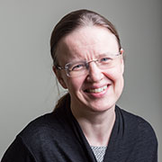
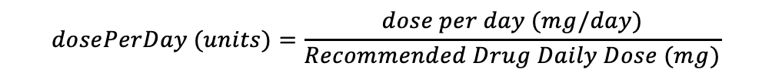
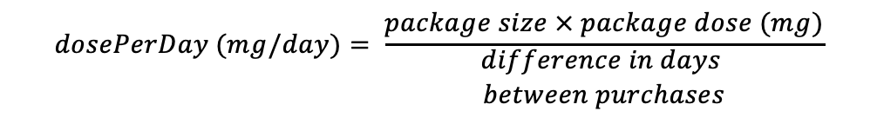
Analysis 2: SSRI Dosage Change over Time
Slide #18
$$dosePerDay (mg/day)= \frac{package size × package dose (mg)}{\begin{aligned}difference in days \\ between purchases\end{aligned}}$$
330,138
235,856
134,748
66,154
114,733
16,216
Generic Name (DDD mg)
Citalopram (20)
Escitalopram (10)
Fluoxetine (20)
Fluvoxamine (100)
Paroxetine (20)
Sertraline (50)
Removal of outliers (<10% and >90%)
Per unit transformation of each drug
$$dosePerDay (units)=\frac{dose per day (mg/day)}{Recommended Drug Daily Dose (mg)}$$
Sum across SSRIs and defined increase/decrease dosage over time
$$Dosage change{=dosePerDay}_{t=n} − {dosePerDay}_{t=0}$$
Increase : positive ”Dosage change”
Decrease: negative “Dosage change”
Janna Suvisaari

Slide 20
SSRI Dosage: Dosage Increase in per unit SSRI over time
Slide #19
Tracking dosage per unit of SSRI increase in months
(median= 40.10)
Trait type:
Survival
No dosage change vs increase in dosage over time
Question:
Are there genetic variants associated with SSRI dosage increase over time?
N=4,021
N=30,152
PTDSS2
chr11:476394:G:A
(intron)
p < 8.43 x 10⁻⁸
AF_{FIN} = 0.01185
AF_{NFE} = 0.02110
β = 0.224
The protein PTDSS2 has a high affinity for docosahexaenoic acid (DHA) : SSRI can be augmented with DHA (Li, Fan, and Wang. 2015. Glycomics and Lipidomics)
Note:
AF – gnomAD allele frequencies in Finns (FIN) and Non-Finnish Europeans (NFE)
Notes:
Used to be SAIGE survival and now GATE
Mention that this is the one variant with the lowest p-value
Too many things -- see if there is a way to make this simpler.
Probably get rid of the
Explain the analysis and then just give the summ stats and mention that there was no GWAS significant hits
Maybe explain about the function, if there is time.
To the best of our knowledge, results shown are novel to depression etiology.
With simple phenotyping, we have shown that there is a genetic basis in SSRI response variability and warrants detailed interrogation.
Future studies:
major depressive disorder polygenic risk contributing to SSRI use and dosage changes
dosage patterns, and
adverse outcomes.

Slide 21
There is a larger proportion of SSRI purchasers compared to MDD
Slide #20
Were we just testing MDD patients for SSRI variability repeatedly?
Phenotype | Phenotype Correlation (r²) | Genetic Correlation (r_{g})
Antidepressants and MDD | 0.444 | 0.997
SSRI and MDD | 0.518 | 0.731
SSRI switch and MDD | 0.00347 | 0.0443
SSRI increase and MDD | 0.00703 | 0.0270

Slide 22
Conclusion and Future Studies
Slide #21
To the best of our knowledge, results shown are novel to depression etiology.
With simple phenotyping, we have shown that there is a genetic basis in SSRI response variability and warrants detailed interrogation.
Future studies:
major depressive disorder polygenic risk contributing to SSRI use and dosage changes
RxNorm for SSRI and EVERY drug recorded in FinnGen
Notes:
these early analyses with simple phenotyping we showed that there is genetic basis in variability and will be studying that in more detail

Slide 23
Project 2: Lifelong medication use in hyperlipidemia, hypertension and type 2 diabetes and CVD risk
Slide #22
Meds for T2D
Meds for Hypertension
Meds for Hyperlipidemia
In FinnGen, phenotypically
r² (CAD) to T2D drugs = 0.4021
r² (CAD) to Hypertension drugs = 0.7604
r² (CAD) to Hyperlipidemia drugs = 0.8532
Note: CVD – Cardiovascular disease
T2D – Type 2 diabetes
CAD -- Coronary artery disease
Limited knowledge on genetic risk factors driving lifelong trajectories of medications used for the prevention of CVD
Notes:
* optimizing pharmacological prevention of CVD involve the identification of patients in need of
drug therapy, setting the targets of the treatment, and selecting therapies of both adequate efficacy and
acceptable risk profiles.
* Ultimately, in addition to socio-economic factors, both the set and dose of medicines
patients start their treatment with and continue to use depends on variation in factors such as cardiovascular
risk profiles, disease etiology, drug responsiveness, and occurrence of adverse effects.
Furthermore, abandoning or inadequately adhering to therapies results in worse outcomes. Therefore, trial and error, patients experience side-effects, do not meet their treatment targets, or experience a cardiovascular outcome like myocardial infarction or stroke.
CV risk increases with diabetes duration and is affected by other comorbidities like hypertension, dyslipidemia, metabolic syndrome, and chronic kidney disease.
Patients with T2D have a higher risk of CVD
lower blood glucose and effectively reduce microvascular target end-organ damage like retinopathy, nephropathy and neuropathy

Slide 24

Objective
Slide #23
Tuomo Kiiskinen
To unravel the genetic architecture of medication use trajectories in hyperlipidemia, hypertension, and T2D with CVD risk
Submitted to Nature Neuroscience

Slide 25
Analysis Plan
Slide #24
Genotyped and Imputed:
Total markers: 16,962,023
Trio of Drug Purchases
218,792 individuals with 3,650,495 purchases
Years = 1995 to 2017
Association Analysis (SAIGE)
Phenotypes tested adjusting for sex, age, batch, and first 10 PCs:
Significance threshold: p < 5x10⁻⁸
Fine-mapping (SuSIE)
3Mb window (± 1.5Mb), pairwise-r² > 0.5
Novelty check (Autoreporting)
Computing r_{g} (LD Score Regression)
There’s more in the paper!
Notes:
don't spell out your covariates (just say "adjusted for a number of covariates" and leave them on the slide for people to read)What is SAIGE?
95 % credible sets and for credible sets with over 10 variants, we report those variants with a ≥ 0.01 probability of being causal.

Slide 26
Drug purchase vs no-purchase
Slide #25
Trait type:
Binary
Purchaser vs non-purchaser
VS
Minimum of ONE purchase
ATC Codes
C10
C02, C03,
C07, C08, C09
A10B
NO / ZERO record of purchase
N_{Hyperlipidemia} = 77,439
N_{Hypertension} = 121,491
N_{T2D} = 31,223
N_{non-hyperlipidemia} = 116,494
N_{non-hypertension} = 72,442
N_{non-T2D} = 162,710
Question:
Are there genetic differences observed with the purchase of these drugs?
Notes:
first starting with non-insulin glucose-lowering agents and later purchasing insulin during the follow-up
C10A = lipid modifying agents
C10AA = statins (hmg co-a reductase)
C02 = antihypertensives (antiadrenergic drugs like methyldopa, antidiuretics (thiazide diuretics) in combination with antihypertensives, ACE 2 inhibitors, Ca channel blockers, beta-adrenergic inhibitors
C03 = diuretics
A10B = Blood glucose lowering drug, excluding insulin
Newer glucose lowering drugs which has been shown to decrease microvascular events
BD = combination of drugs
BH = DPP-4 inhibitors
BJ = glucagon-like peptide 1 (GLP-1) analog (injectable)
BK = sodium glucose co-transporter 2 (SGLT2) inhibitors
C07 = beta blocking agents
C08 = calcium channel blockers
C09 = renin-angiotensin inhibitors (ACE inhibitors)

Slide 27
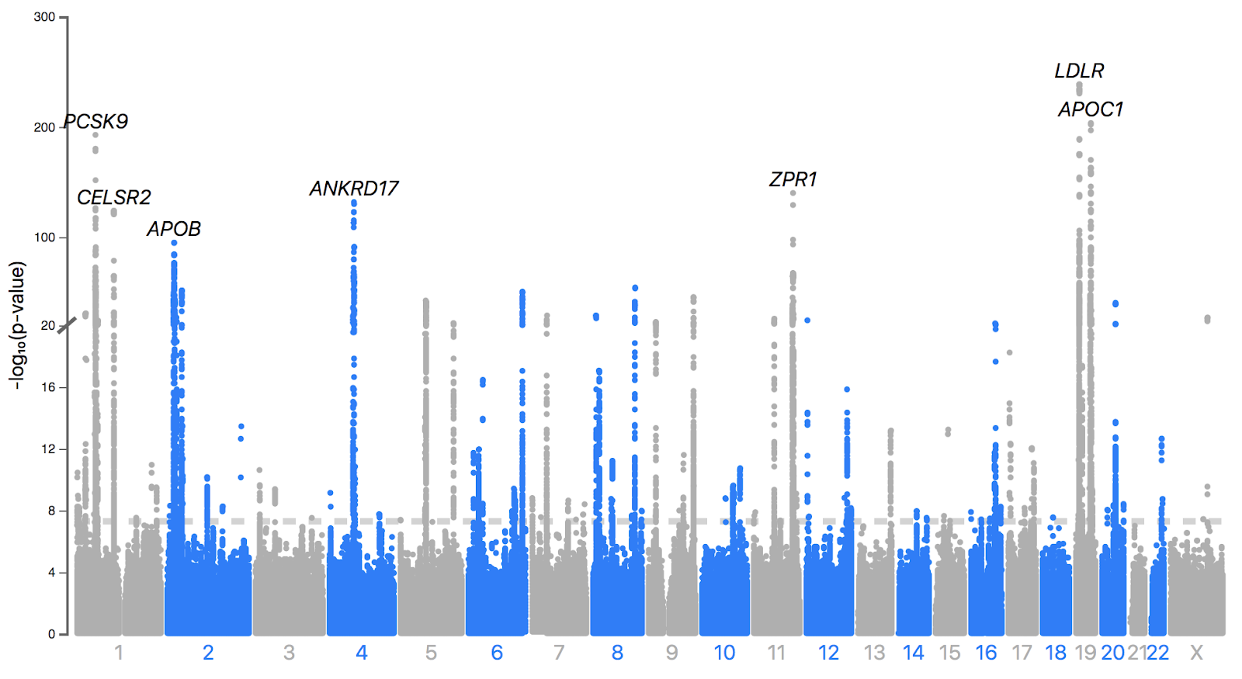
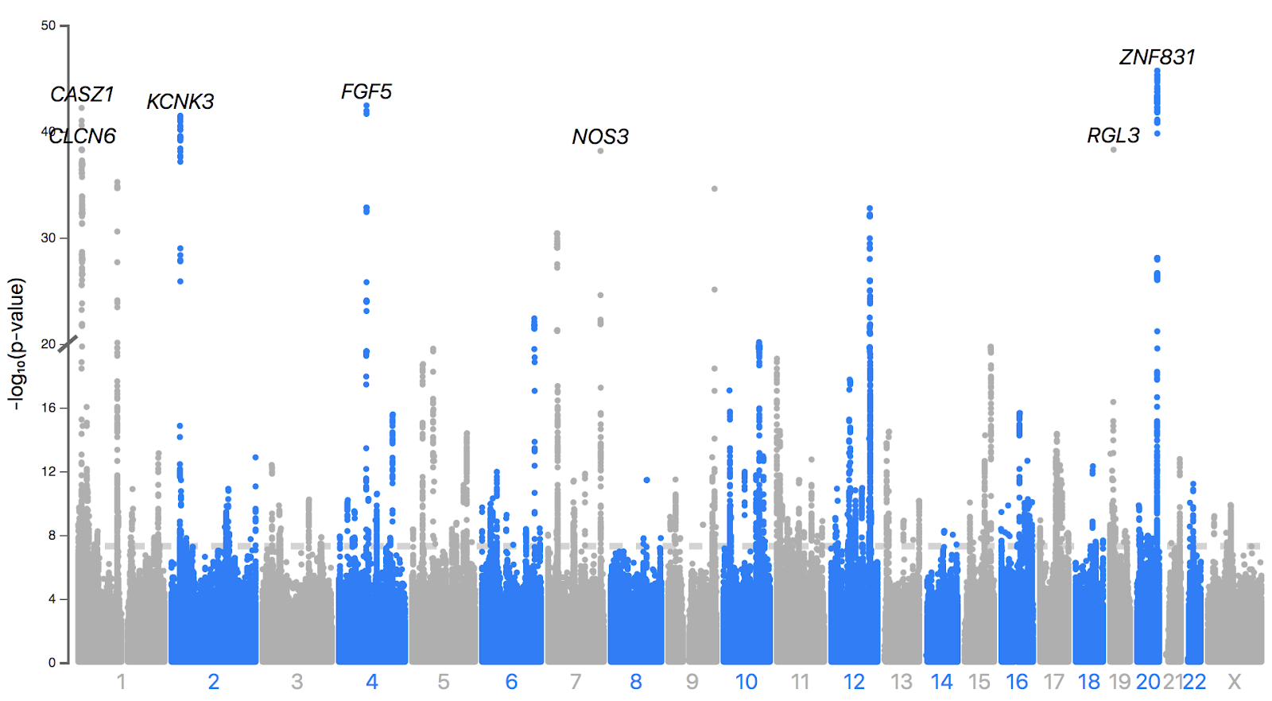
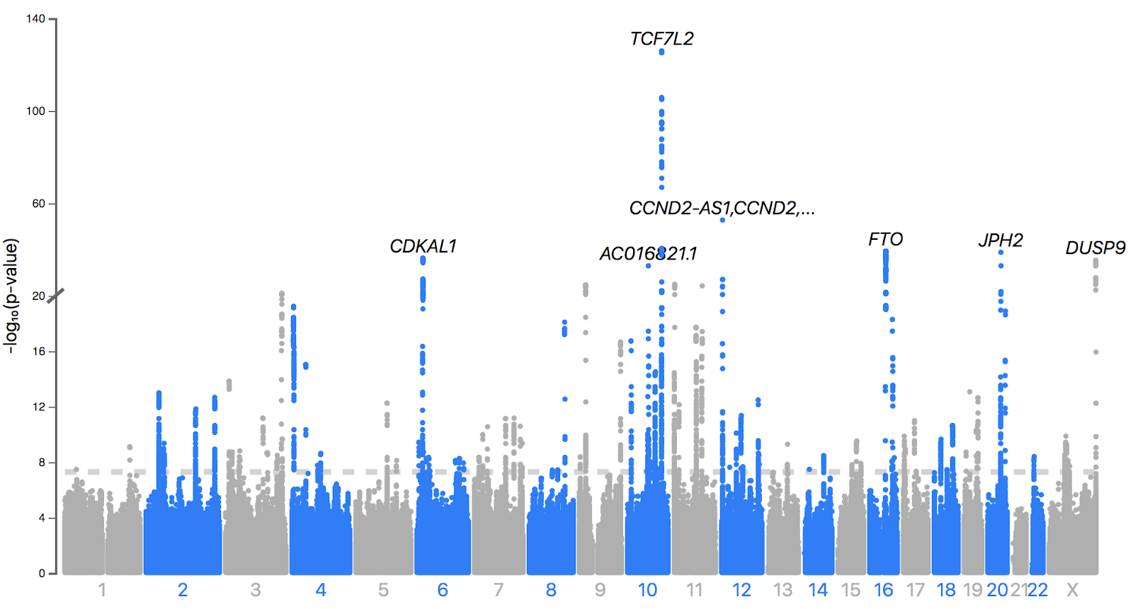

Binary Associations of the Trio drug purchases (within 1.5 Mb)
Slide #26
Hyperlipidemia (91 loci)
Hypertension (145 loci)
N_{purchases} = 77,439
N_{purchases} = 121,491
T2D (67 loci)
N_{purchases} = 31,223
Juha Karjalainen
Notes:
Hyperlipidemia:
Out of the 91 and even upon fine mapping, All the loci with the strongest associations in our analysis (p_{lead variant}<10⁻¹⁰⁰, BF_{CS}>10¹⁰⁰), were well-established lipid loci (APOE, LDLR, PCSK9, APOC1, CBLC, ANKRD17).
Only 12 were possibly novel
Hypertension:
Out of 145, only 18 not previously reported, especially something close to Chr16 which seems to have previously reported lipid lowering but not CVD or BP lowering
T2D:
Out of 67, only 4 from finemapping were highly enriched on chr18 which is relatively unknown but highly enriched in Finland by almost 130 fold
270 of the 294 lead SNPs available in the replication analyses had concordant effect directions (p_{binomial}=3.2x10⁻⁵⁵) in UKBB and Estonian Biobank
>80% of signals have been previously reported

Slide 28
Most of these signals were previously reported for the underlying CVD risk factor being the indication of the medication use (>85.2% )
Slide #27
Question:
Are there shared genetic correlative impacts between drug purchases and CVD risks?

Slide 29
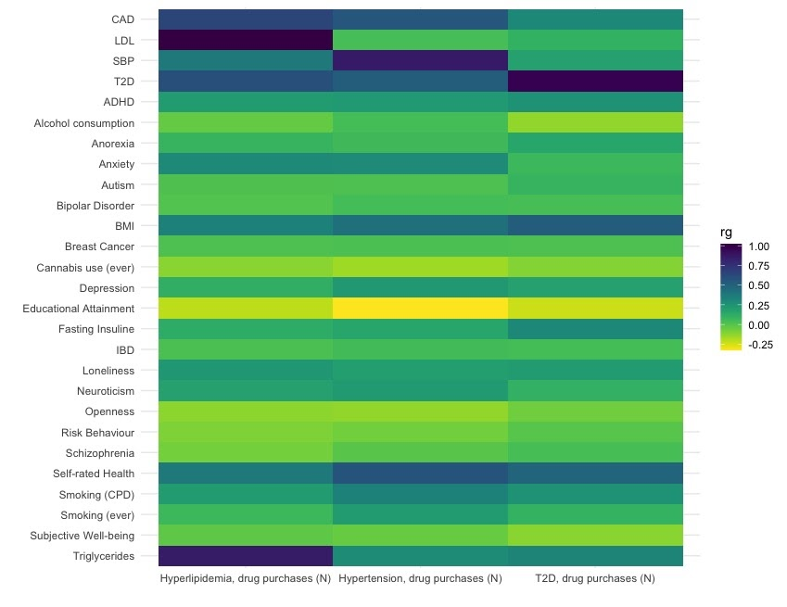

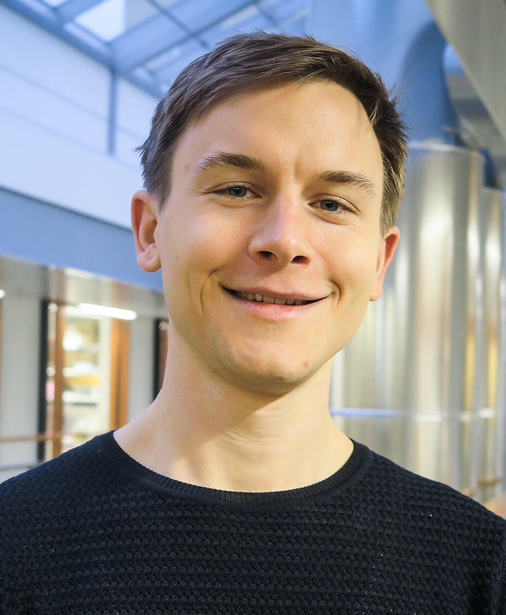
r_{g} between CVD Traits and Drug Purchase
Slide #28
Masa Kanai
THE FineMapper
Pyry Helkkula
Notes:
Fine-mapping using SuSIE, regions were formed using a 3Mb window (± 1.5Mb)
of the 477 non-overlapping analysis specific GWS regions → 345 high correlation (r² between variants in the set at least 0.5) 95% credible sets (CS) with variant counts ranging from 1 to 221 with each set encompassing a range of 0 – 13 functional missense or predicted loss-of-function (pLOF) variants.
Genetic correlations between the total number of medication purchases used in treatment of hyperlipidemia, hypertension and type 2 diabetes and selected cardiometabolic and behaviour-related traits.

Slide 30
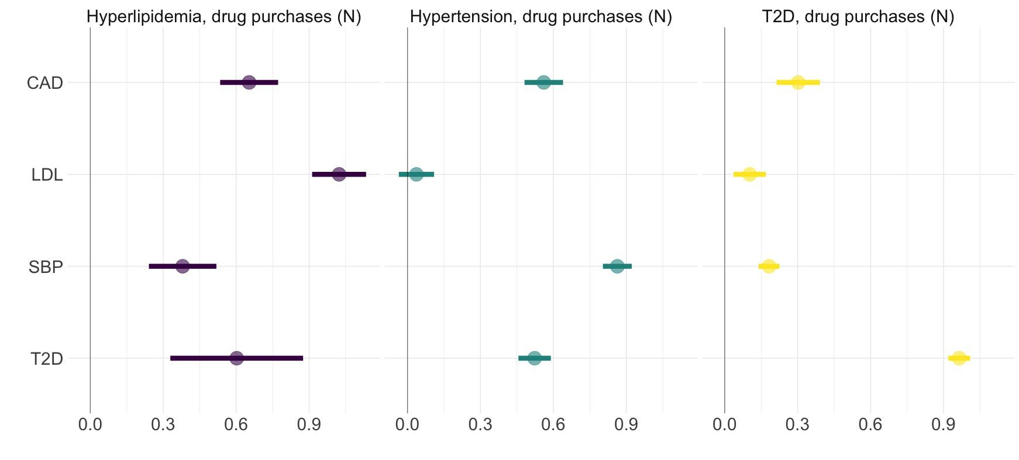
r_{g} between Total Number of Drug Purchases and Underlying Cardiometabolic Risk Factors and CAD
Slide #29
Median = 25
Median = 43
Median = 29
Notes:
Using LDSC, high genetic correlations between the drug use quantity or patterns and the underlying indications for which the medications used: lipid drugs and LDL, BP drugs and SBP, T2D drugs, and T2D, in all cases RG>0.95
correlation estimate between the total number of hypertension medication purchases and LDL was the only non-significant correlation in the analysis (RG=0.03, p=0.32), the genetic correlation between the number of purchased lipid-lowering drugs and systolic blood pressure was clearly significant with a moderate point estimate (RG=0.38, p=8.2e10⁻⁸).

Slide 31
Conclusions
Slide #30
These medications are prescribed to individuals with the strongest genetic liability to elevated CVD risk factors
r_{g} were highest between the medication and its underlying risk factors which are the direct targets of the treatment.
More in the paper! Submitted to Nature Neuroscience
Tuomo Kiiskinen
Notes:
these early analyses with simple phenotyping we showed that there is genetic basis in variability and will be studying that in more detail

Slide 32
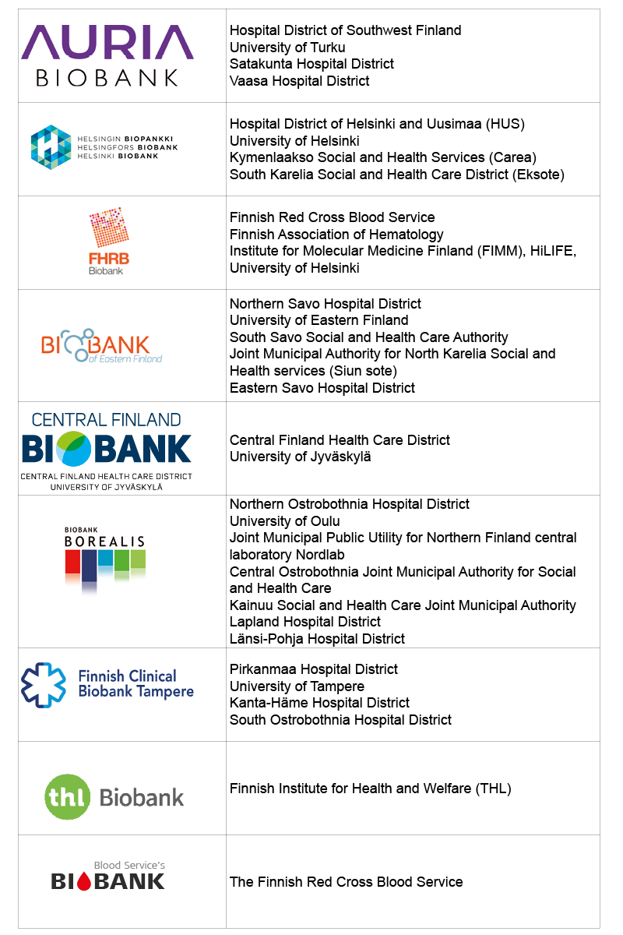



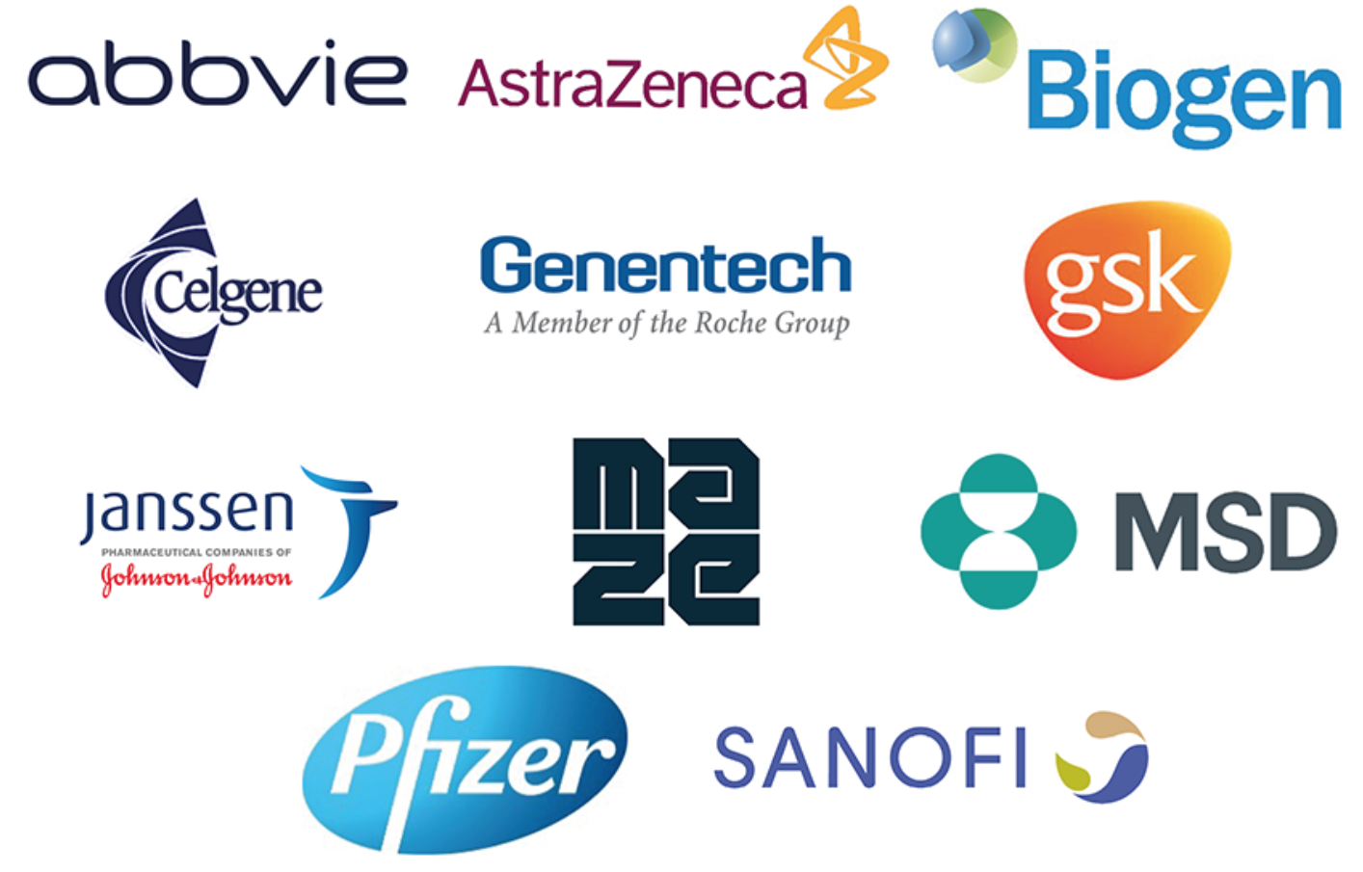
Slide #31
FinnGen Partners
Coordinating partners:
Biobanks:
Funding:
Funding partners:

Slide 33
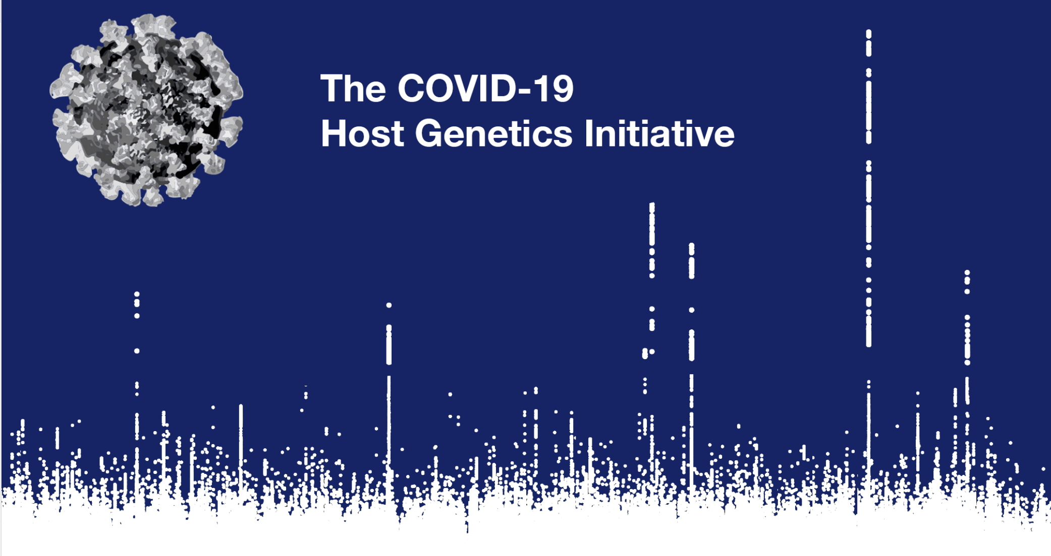
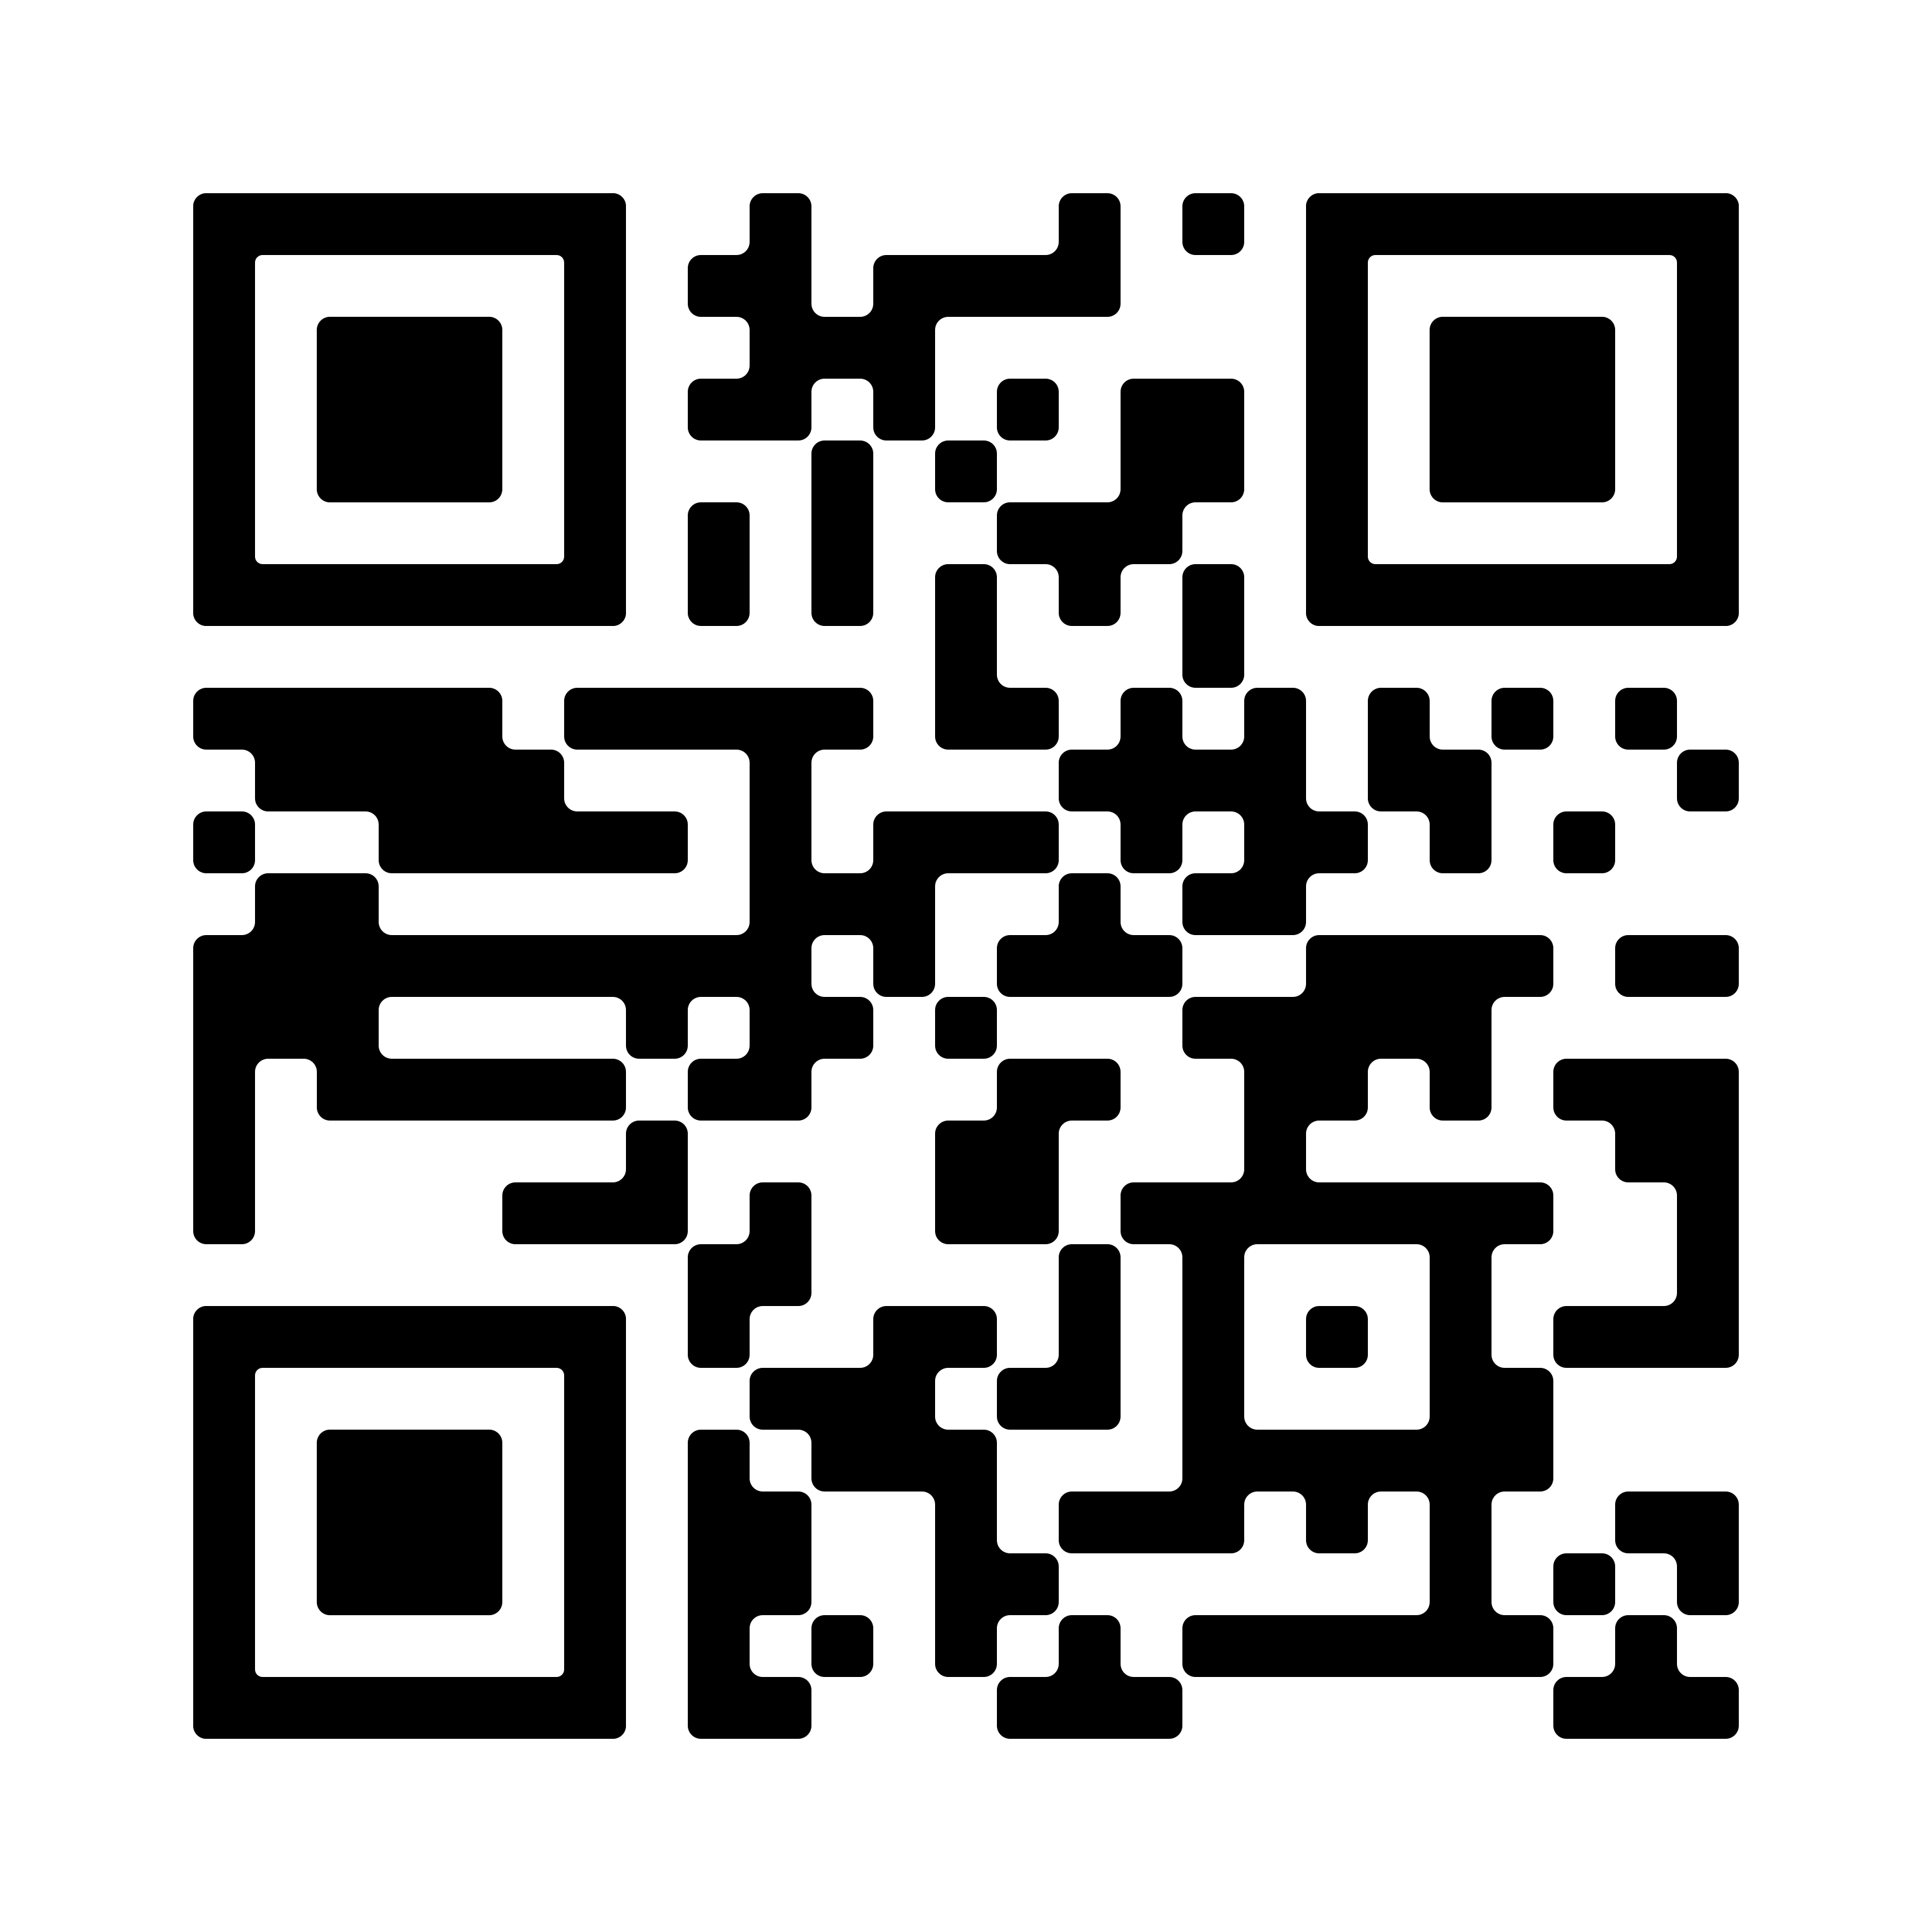

Slide #32
Largest GWAS in history (>2 million people)
Largest number of global collaborators (> 3,000 scientists)

Slide 34
Suuri kiitos! Onko kysyttävää?
Paljon kippiksia
Mark Daly, PhD
Mitja Kurki, PhD
Ben Neale, PhD
Tuomo Kiiskinen, MD
Juha Karjalainen, PhD
Ari Ahola-Olli, MD, PhD
Pietro Della Briotta Parolo, PhD
Jaana Suvisaari, MD, PhD
Wei Zhou, PhD
Hanna Ollila, PhD
Aarno Palotie, MD, PhD
Be on the lookout for our FinnGen flagship
paper that’s being submitted to Nature soon!
Novartis Interview for Human Genetics Data Scientist,
Chemical Biology and Therapeutics
November 24th, 2021
Kumar Veerapen, PhD
Computational Scientist I
Daly and Neale labs
@mkveerpn
veerapen@broadinstitute.org
#ATGUstrong

Slide 35

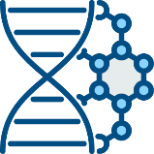

Why Finland?
Unique genetic ancestry
Biobanks
Comprehensive high-quality health care system
Highly educated experts
FINLAND
Government support
National health registers
TRANSFORMATION OF PHARMACEUTICALS
PERSONALIZED
MEDICINE

Slide 36
Drug Response and Efficacy
Phamacogenomics: variability of drug response and efficacy is contributed by genetic risk factors
FDA list of 127 biomarkers in 27 therapeutic areas (mostly cyp genes)
ADME > Disease >Target (Nelson et al. 2016, Nat Rev)
Poor functional characterization
Summary statistics PrediXcan (Gamazon et al. 2005, Nat Gen)
NIH PGRN and eMERGE – grants for sequencing such as the RIGHT dataset (mostly interrogation in known biomarkers, lack of phenotype)
The “druggable” genome -- PharmGKB
Dosage, use frequency, response, cessation --> Biobanks?
Note
ADME -- drug absorption, distribution, metabolism and excretion
PGRN – Pharmacogenomics Research Network
Notes:
Traditionally: The studies performed during the decade of the 1990s often focused on isoforms of the CYPs as an extremely important family of drug-metabolizing enzymes,
Gilbert: s TATA box, but some subjects have 7 rather than 6, and they display decreased expression of both UGT1A1 messenger RNA and protein, resulting in Gilbert syndrome because of reduced bilirubin metabolism and, when they are exposed to irinotecan
esponsible for the biotransformation of most foreign substances including 70–80% of all drugs in clinical use.
, if we just select 2 common and intensively studied CYP genesdCYP2C9 and CYP2C19dgenes that encode enzymes that metabolize the anticoagulant agents warfarin and clopidogrel
drugmetabolizing enzymes, drug transporters, and drug targets, proteins that might logically be expected to influence drug response. F
Citalopram
Psyhiatry
CYP2C19, CYP2D6
Amitriptyline
Psychiatry
CYP2D6

Slide 37
Distribution of Drug Use
 | ATC-codes | N (Ind) | Cases | Controls
Treatment of hyperlipidemia (C10)
Cessation of statin | C10AA | 76,499 | 7,459 | 68,990
Changing simvastatin to another statin | C10AA01 | 45,134 | 19,228 | 25,906
Treatment of hypertension
More than 1 antihypertensive groups | C02, C03, C07, C08, C09 | 125,586 | 82,551 | 43,035
More than 2 antihypertensive groups |  | 125,586 | 50,482 | 75,104
More than 3 antihypertensive groups |  | 125,586 | 22,476 | 103,110
All 5 antihypertensive groups |  | 125,586 | 2,900 | 122,686
Treatment of type 2 diabetes (A10B)
Use of 2nd line agents in T2D | A10BD, A10BH, A10BJ, A10BK | 31,665 | 14,292 | 17,373
Use of insulin | A10A | 29,990 | 6,861 | 23,129
The number of cases and controls for the binary traits
Notes:
first starting with non-insulin glucose-lowering agents and later purchasing insulin during the follow-up
C10A = lipid modifying agents
C10AA = statins (hmg co-a reductase)
C02 = antihypertensives (antiadrenergic drugs like methyldopa, antidiuretics (thiazide diuretics) in combination with antihypertensives, ACE 2 inhibitors, Ca channel blockers, beta-adrenergic inhibitors
C03 = diuretics
A10B = Blood glucose lowering drug, excluding insulin
Newer glucose lowering drugs which has been shown to decrease microvascular events
BD = combination of drugs
BH = DPP-4 inhibitors
BJ = glucagon-like peptide 1 (GLP-1) analog (injectable)
BK = sodium glucose co-transporter 2 (SGLT2) inhibitors
C07 = beta blocking agents
C08 = calcium channel blockers
C09 = renin-angiotensin inhibitors (ACE inhibitors)

Slide 38
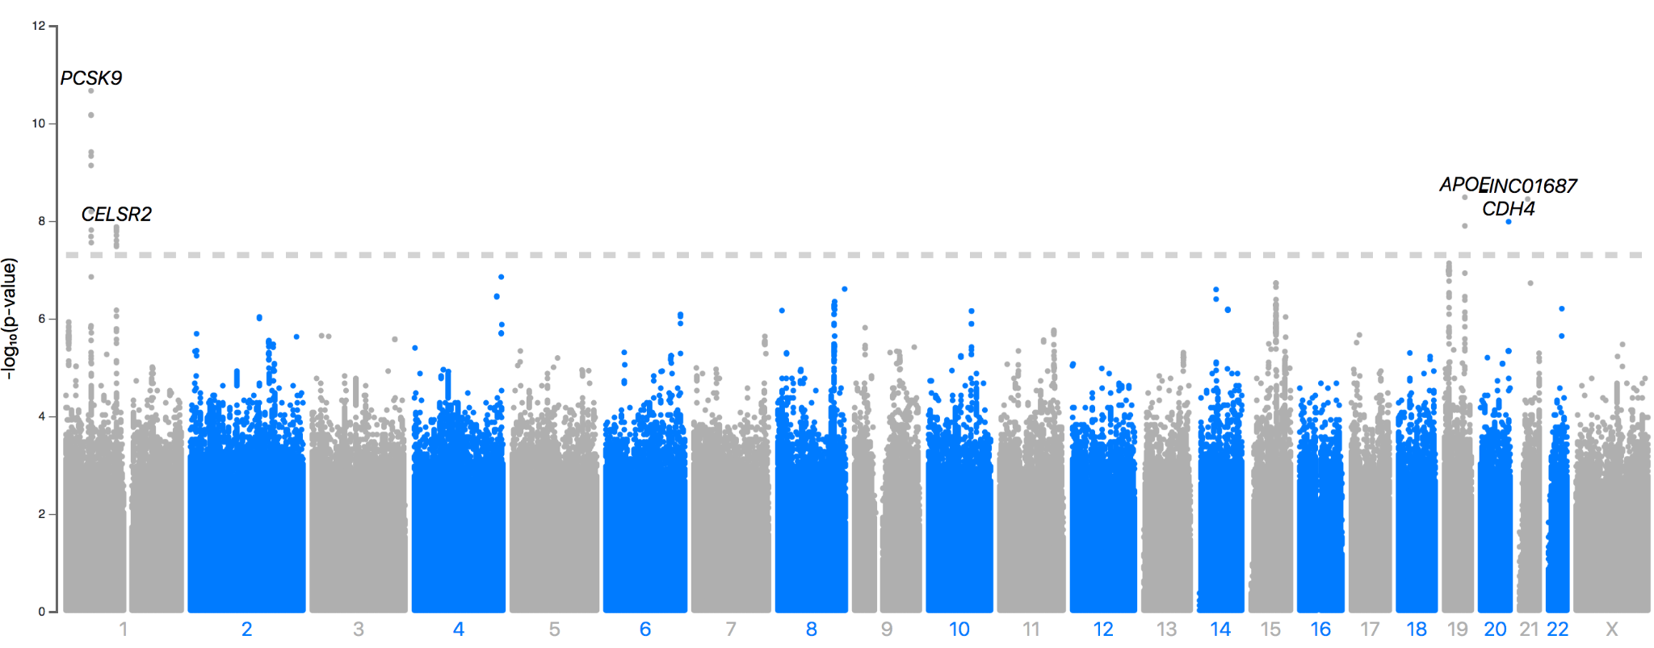
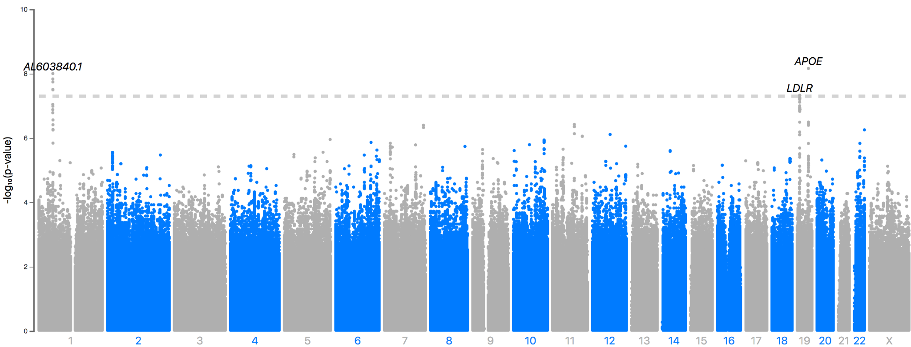
Statin Switching and Cessation
Switching statins
N_{switchers} = 19,228
N_{non-switchers} = 25,906
Cessation of statins
N_{cessations} = 7,459
N_{non-cessations} = 25,906
Notes:
Switching
four established lipid loci (PCSK9, CELSR2, APOE, CHD4) were associated with switching from simvastatin to another statin
Chr21 : AP000472.2 novel but nominally significant to CVD phenotypes in phewas
Cessation
PCSK9, LDLR, APO
CS both contained previously reported missense variants (rs11591147/PCSK9, r7412/APOE) known to be protective against hyperlipidemias, coronary artery disease, and Alzheimer’s disease (#30) which increased the probability of statin discontinuation

Slide 39
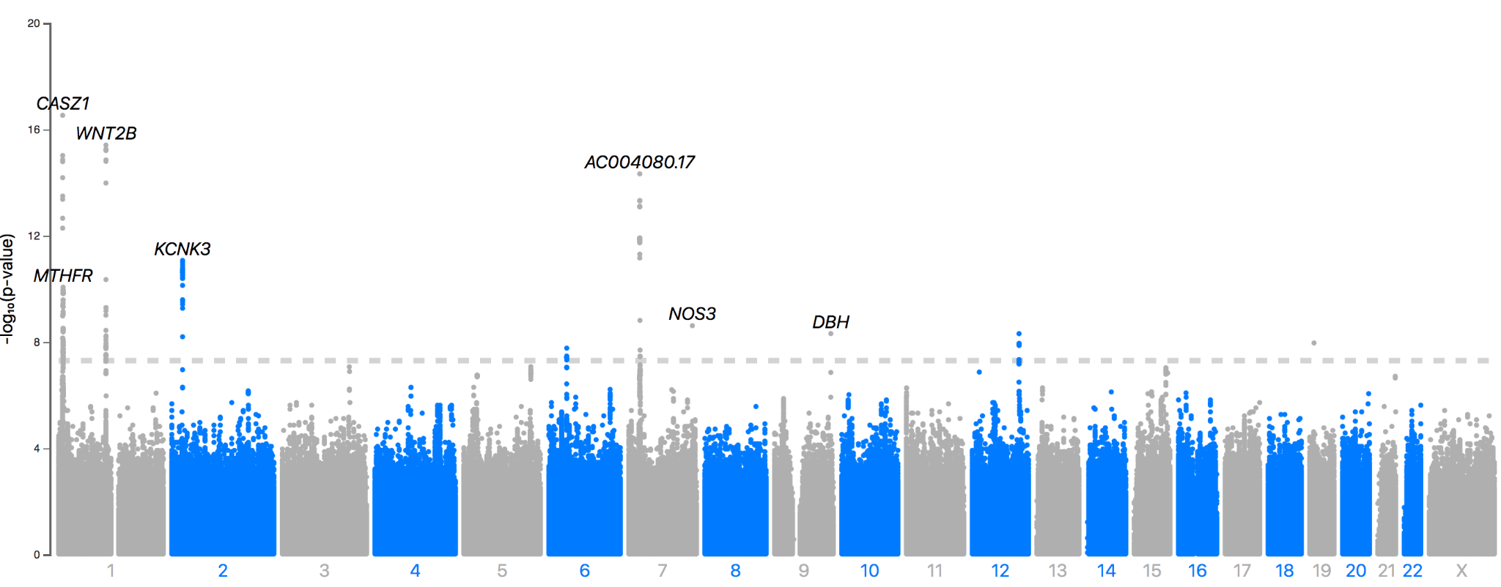
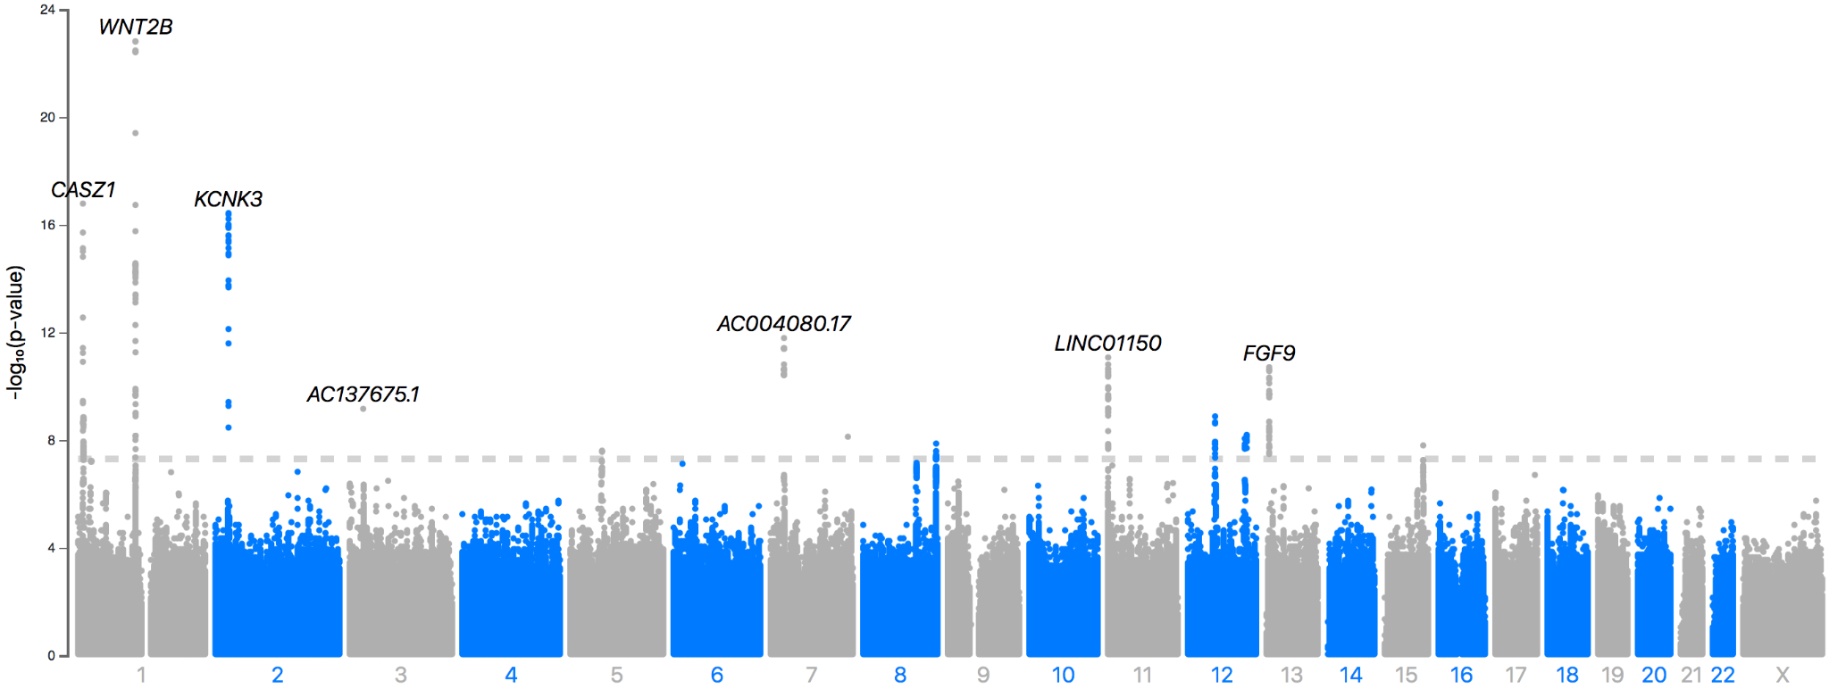
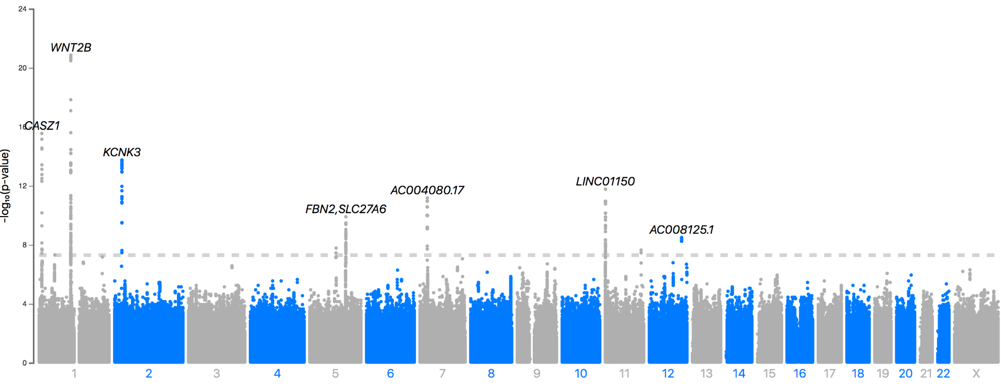
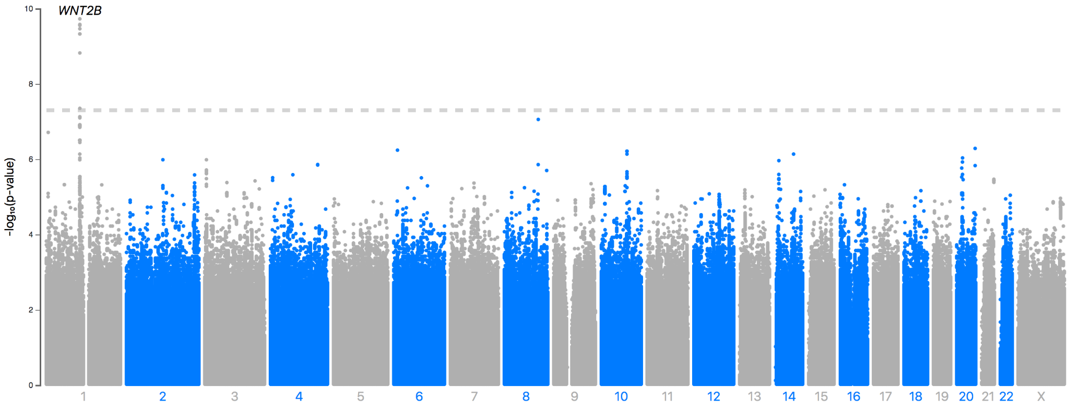
Antihypertensives
1 | 82,551 | 43,035
>=2 | 50,482 | 75,104
>=3 | 22,476 | 103,110
>4 | 2,900 | 122,686
Notes:
anti-Hypertensives
14 previously reported blood pressure loci containing 32 credible sets had also significant associations in the GWASes with the number of different purchased hypertension drug groups.
WNT2B in all analyses
HOXA13, CASZ1, KCNK3) were all associated with the use of more than 1, 2, or 3

Slide 40
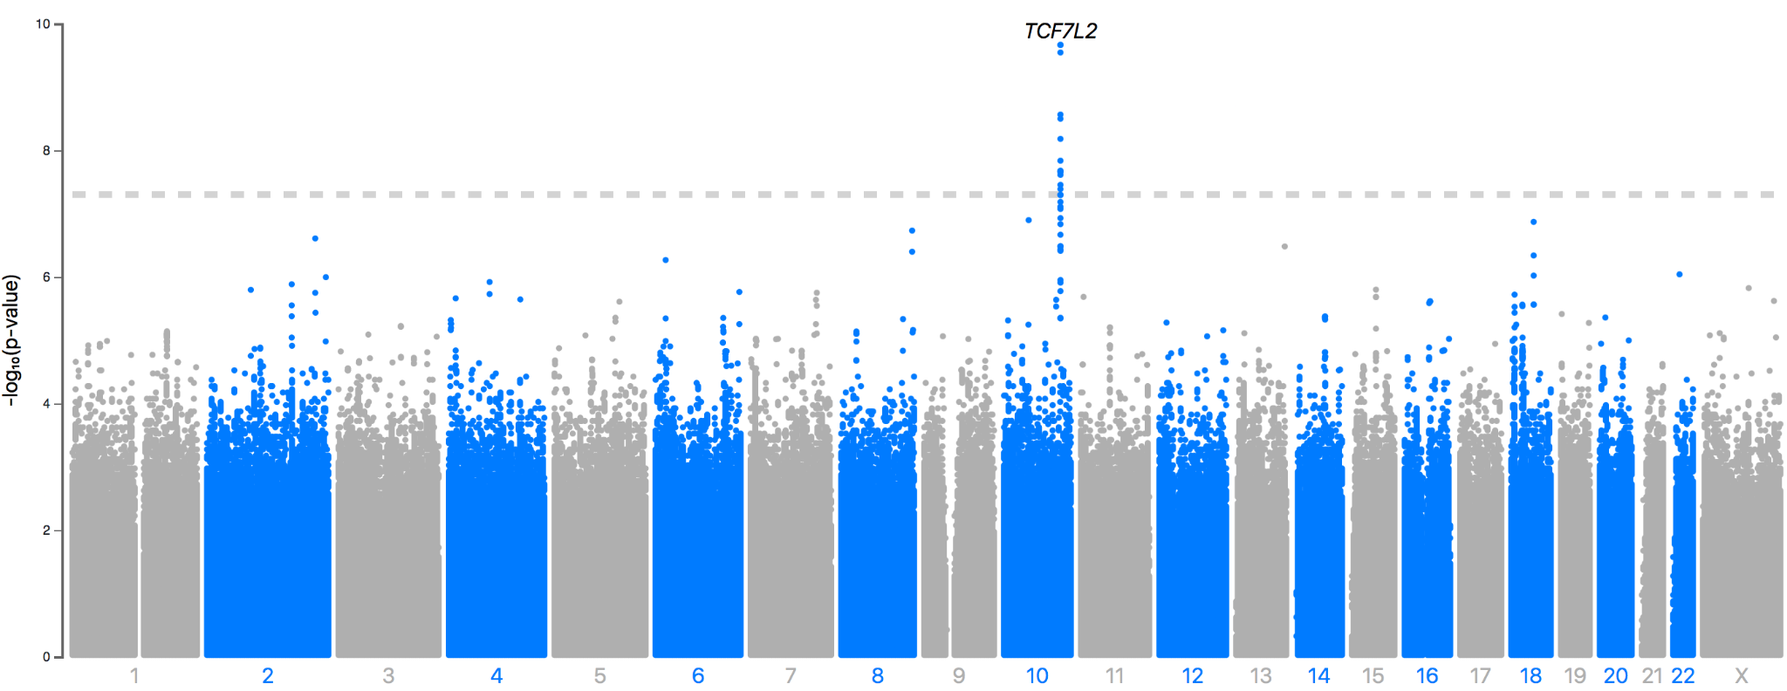
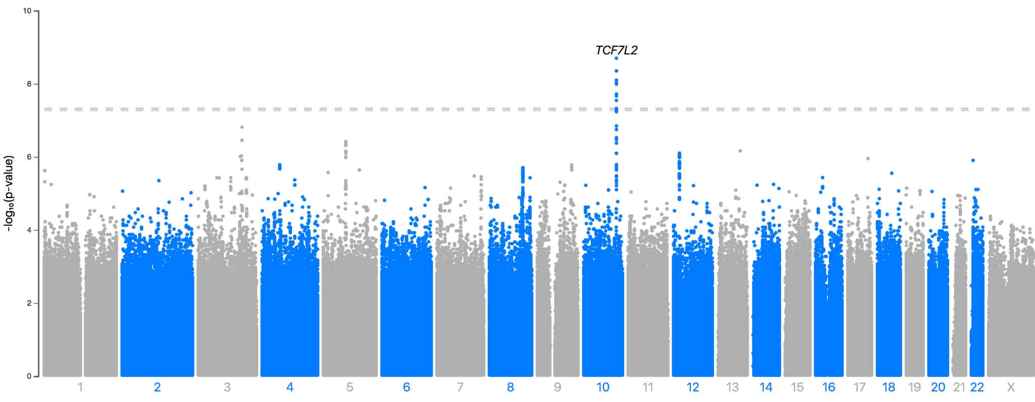
T2D Drugs
Use of 2nd line | 14,292 | 17,373
Use of insulin | 6,861 | 23,129
Notes:
a previously reported T2D locus (TCF7L2, 1 CS per analysis), being the only GWS loc

Slide 41
PRS: MTAG-CAD PRS and CAD in UKBB
PRS | >99%(OR) | >95%(OR) | ≤5%(OR) | ≤1%(OR) | AUC (covariates) | AUC (full model, training dataset) | AUC (full model, validation dataset) | AUC (PRS only, validation dataset) | R2 (PRS only, full dataset)
CAD | 4.40(3.96-4.89) | 2.07(1.99-2.16) | 0.53(0.47-0.60) | 0.23(0.17-0.32) | 0.755(0.754-0.755) | 0.785(0.785-0.785) | 0.784(0.784-0.785) | 0.635(0.635-0.636 | 0.035
MTAG-CAD | 4.96(4.48-5.49) | 2.24(2.15-2.34) | 0.47(0.42-0.54) | 0.22(0.16-0.31) | 0.755(0.754-0.755) | 0.791(0.791-0.791) | 0.790(0.790-0.791) | 0.649(0.649-0.65) | 0.043
Notes:
Table 3: Comparison of associations between traditional and MTAG-based CAD polygenic risk scores and CAD in the UKBB. The middle quintile of the PRS (40th to 60th percentiles) was used as the reference group. The AUCs and R2 were calculated using PRSs as continuous variables in the models.

Slide 42
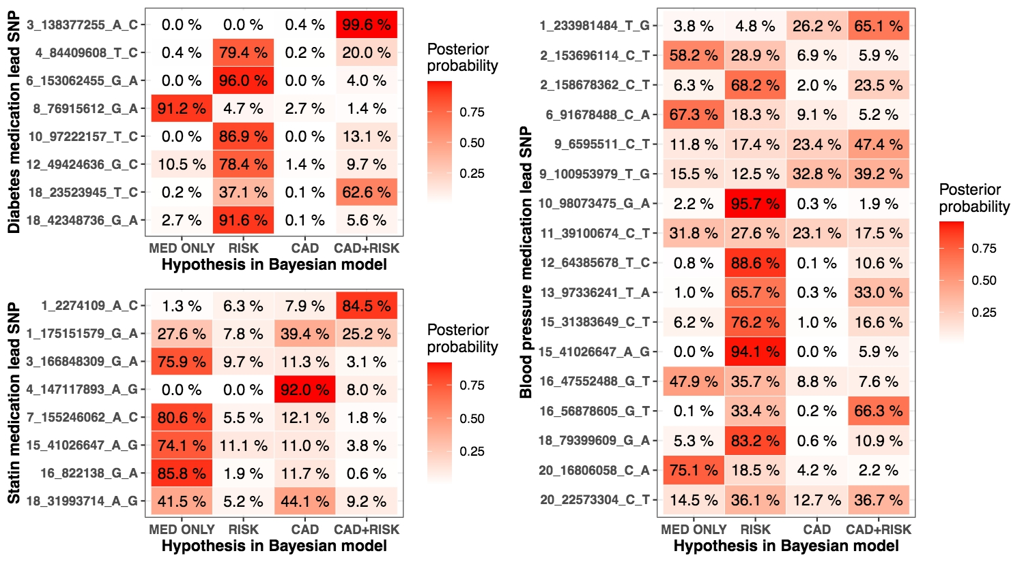
Colocalization using a Bayesian framework
Notes:
Bayesian framework (Methods) to assess shared impact with the underlying risk factor and CAD in the 33 novel autosomal associations found in both the risk factor summary statistics and CAD meta-analysis.
We found a likely CAD association (PIP > 60 %) in nine loci.
This included a locus (rs4835377-G near TTC29) associated with CAD and statin medication that did not associate with the underlying risk factor (LDL cholesterol).
On the other hand, nine loci did not associate to either the considered risk factor or CAD [P(MED ONLY) > 60 %], likely linking to other indications contributing to these associations.
For the remaining 15 autosomal loci, an impact on coronary artery disease is possible but not certain.
Furthermore, 31 of the 45 CS lead SNPs were associated (p<0.05/231) with at least one of the 231 cardiometabolic endpoints in FinnGen

Slide 43
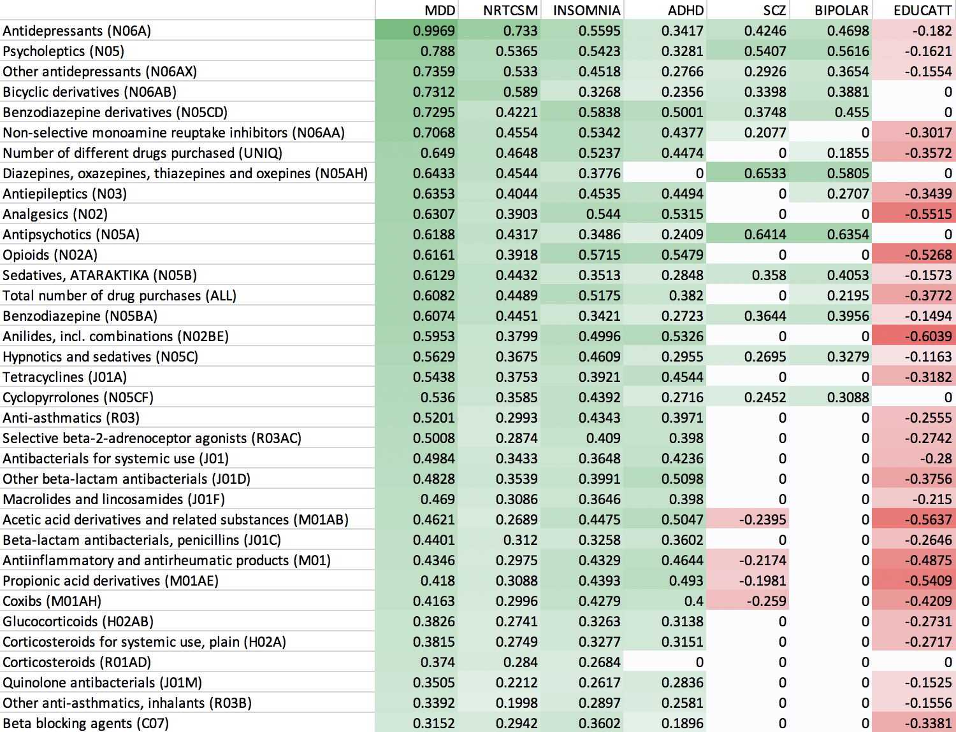
Genetics of use of various drugs correlate with psych traits
LDSC rg
Bonferroni non-significant
correlations are 0

Slide 44
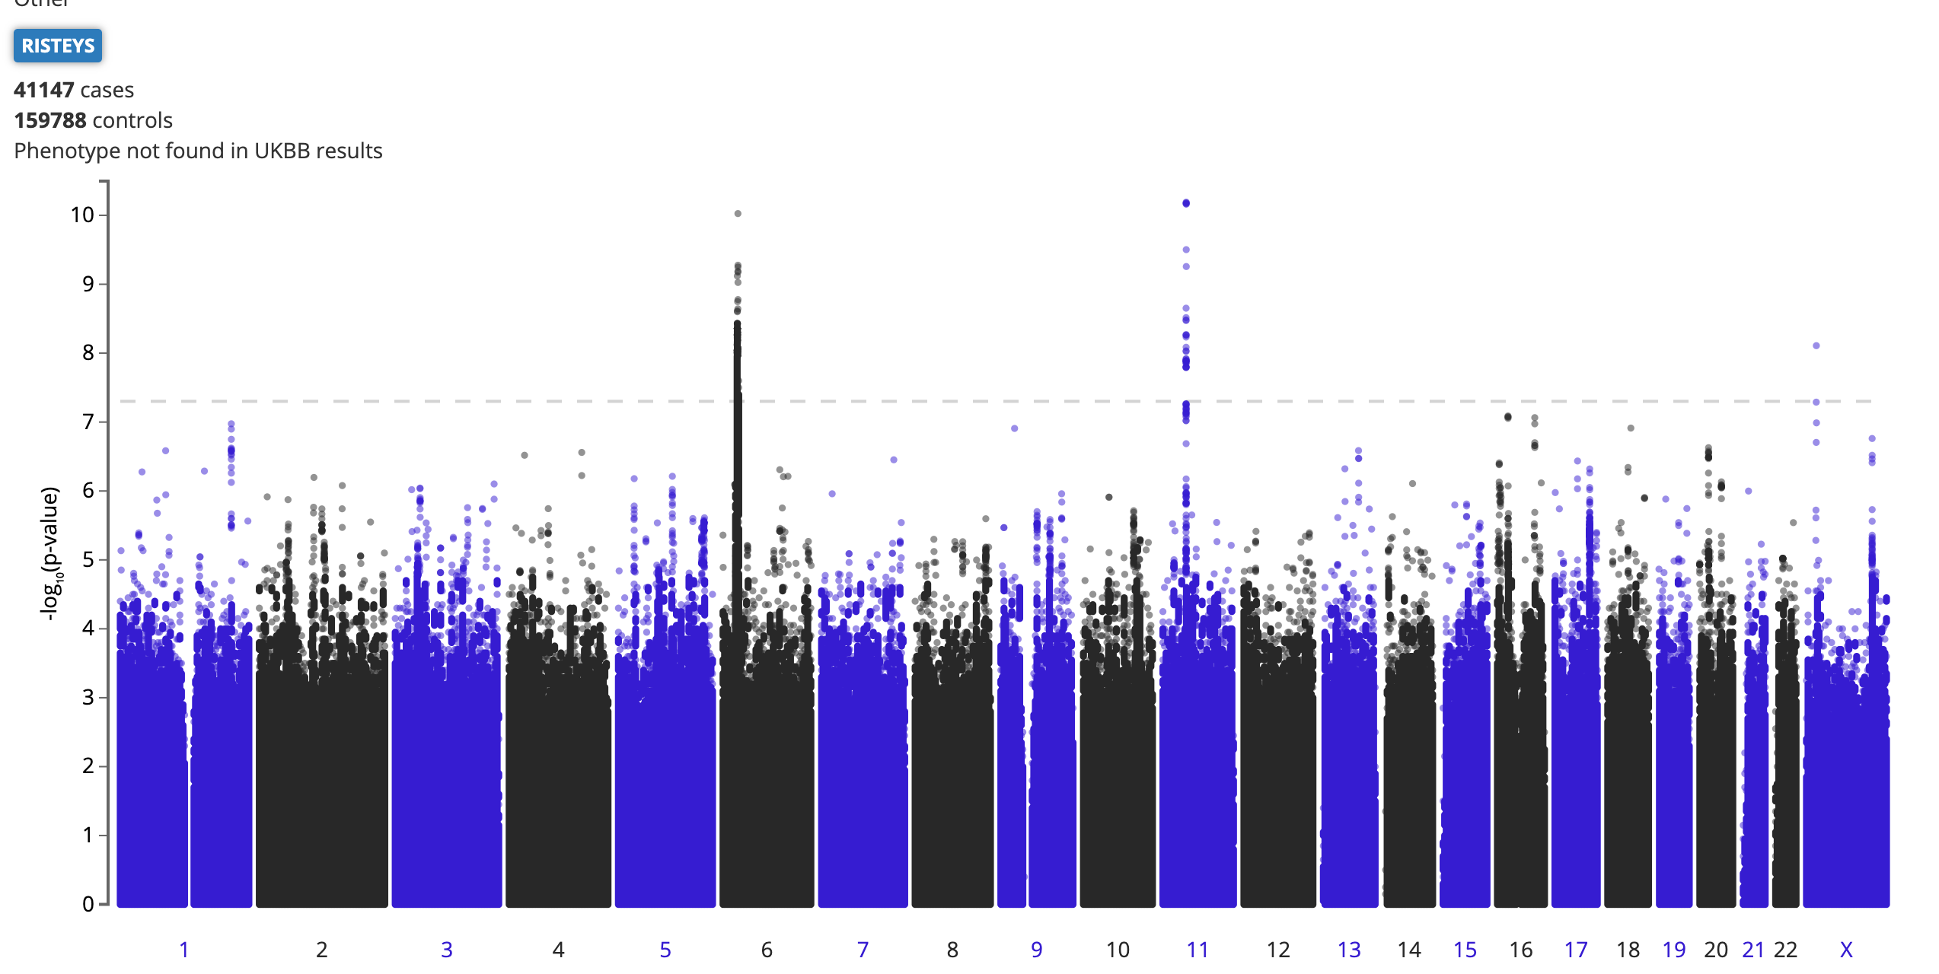
SSRI (N = 41,147) vs non-SSRI purchase (N = 159,788)
HLA-A
chr6:29978172:G:A
(intron)
AF_{FIN} = 0.0637
AF_{NFE} = 0.1131
β = -0.115
PHF21A
chr11:46035522:T:C (intron)
AF_{FIN} = 0.1988
AF_{NFE} = 0.1715
β = 0.0747
Endpoint: Binary
SSRI purchase/no purchase (0/1)
RPS6KA3
chrX:20353947:G:A
(intergenic)
AF_{FIN} = 0.03235
AF_{NFE} = 0.005866
β = 0.121
The enzyme PHF21A mediates repression of neuron-specific genes, potentially impairing serotonin metabolism in mice (Garay et al. 2016 Epigenomics).
Notes:
AF – gnomAD allele frequencies in Finns (FIN) and Non-Finnish Europeans (NFE)
Notes:
57883324 for 11 46035522
27867657 for 6
PHF21A mediates repression of neuron-specific genes, potentially impairing serotonin metabolism in mouse models (Garay et al 2016, Epigenomics)
Spend more time here
AF spectrum, the biggest MDD and how do they compare to this, possibly side by side, were these novel to MDD.
MDD pvalues from the phewas, table comparing betas, pvalues,
HLA is new and not captured in meta-analysis

Slide 45
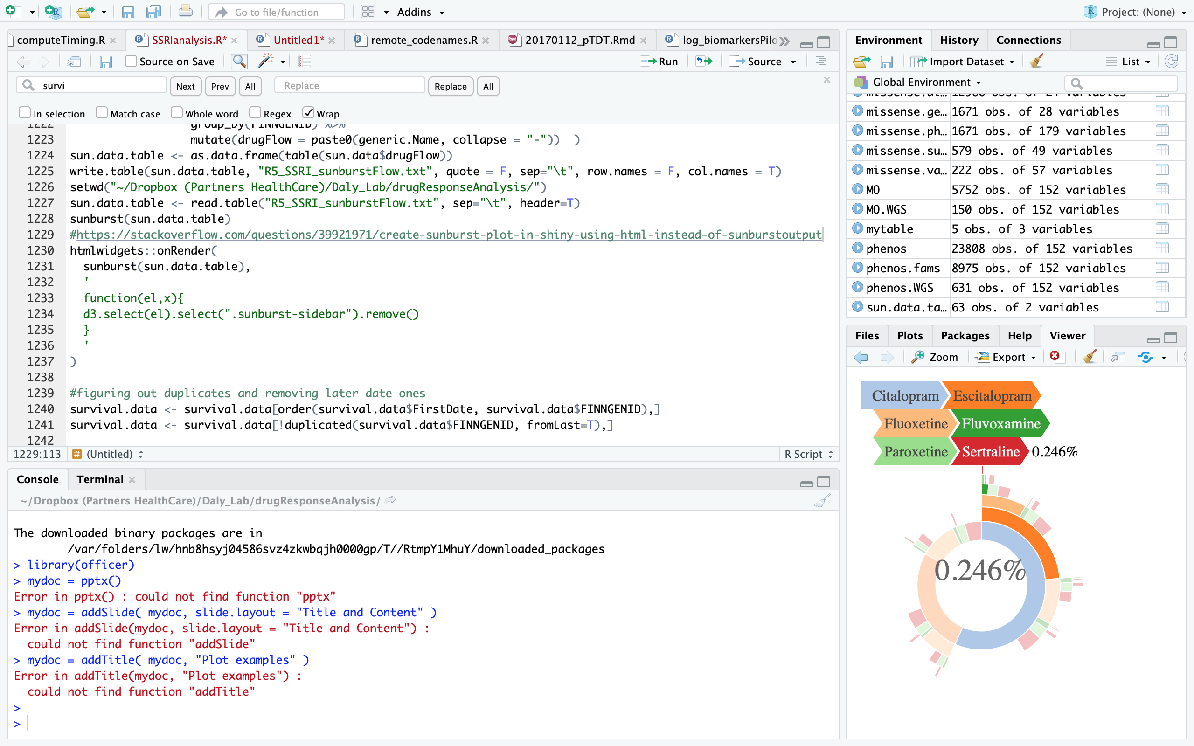
SSRI Usage Patterns
Slide #28
SSRI | Number of FinnGen IDs | Final count from latest purchases
Citalopram | 27,545 | 18,052
Escitalopram | 24,118 | 20,053
Fluoxetine | 13,981 | 6,791
Fluvoxamine | 2,282 | 933
Paroxetine | 5,655 | 2,957
Sertraline | 11,737 | 7,733
TOTAL | 85,318 | 56,519
SSRI Usage
N* = 85,318
* 28,799 points consume > 1 SSRI
** number of people = 20,430

Slide 46
Analysis 2: SSRI Adherence
Slide #26
Total antidepressant users: 86,404
Note:
NotSSRI includes (based on ATC code)
Non-selective monoamine reuptake inhibitors
Monoamine oxidase inhibitors
Monoamine Oxidase A inihibitors
Other antidepressants
Did not switch
from SSRI
N=22,778
VS
Trait type:
Binary
Switched from SSRI to any other antidepressant
N=17,789 (40,567 - 22,778)
Purchases SSRI only vs switched to another antidepressant
Question:
Are there genetic variants associated with switching from SSRI to
any other antidepressant?

Slide 47
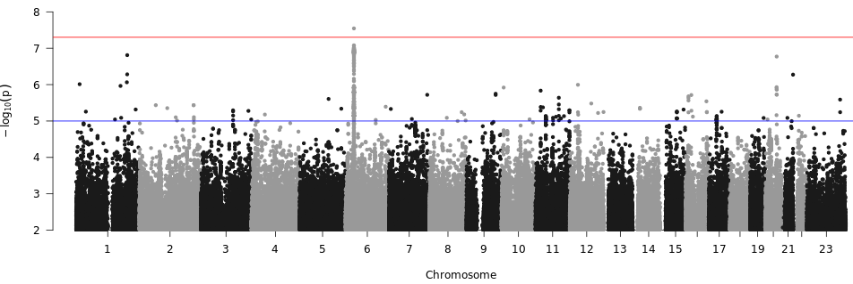
SSRI Adherence: From SSRI (N=22,778) to Any Other Antidepressant (N=17,789)
Slide #27
Not everyone sticks to SSRI as their effective antidepressant
HLA-DQB1
chr6:32658495:C:A
AF_{FIN} = 0.2567
AF_{NFE} = 0.2717
β = -0.106
Endpoint: Binary Switch Status (0/1)
MDD to Antidepressants
r_{g} = 0.997
MDD to SSRI Adherence
r_{g} = 0.431
Note:
AF – gnomAD allele frequencies in Finns (FIN) and Non-Finnish Europeans (NFE)
r_{g} – genetic correlation
Notes:
18,691 vs 13202
What is the endpoint and how did I define it?
Spend more time here
MAGMA results in Howards paper
SSRI contraindications to T1D
6 32658495 C A 9.690e-08 -0.1060 0.0199 2.872e-01 2.739e-01 2.960e-01 950.06 4835.53 1705.13 7653.18

